Slide 1
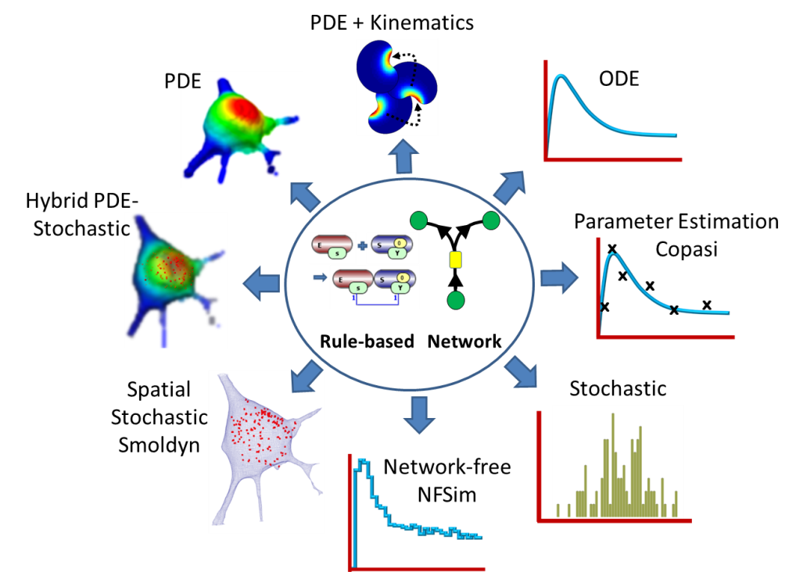

VCell
A modeling environment for the simulation of cellular events; download at http://vcell.org .
Virtual Cell is developed by the Center for Cell Analysis and Modeling at the University of Connecticut Health Center. It is funded as a Biomedical Technology Research Resource by the National Institute of General Medical Sciences (NIGMS)

Slide 2
VCell Tutorial
FRAP with binding
Create a simple biomodel and spatial (PDE) application to simulate a photobleaching experiment with both diffusion and binding.

Slide 3
In this tutorial you will:
Gain a basic introduction to the Virtual Cell interface
Create a simple biomodel with species and reactions
Create a compartmental (ODE) application of the model to determine steady state binding conditions.
Create a spatial deterministic (PDE) application using analytic equations to create a simple geometry
Define initial concentrations that are non-uniform using Boolean expressions
Create a timed event in a spatial simulation.
View and analyze results of a spatial simulation.

Slide 4
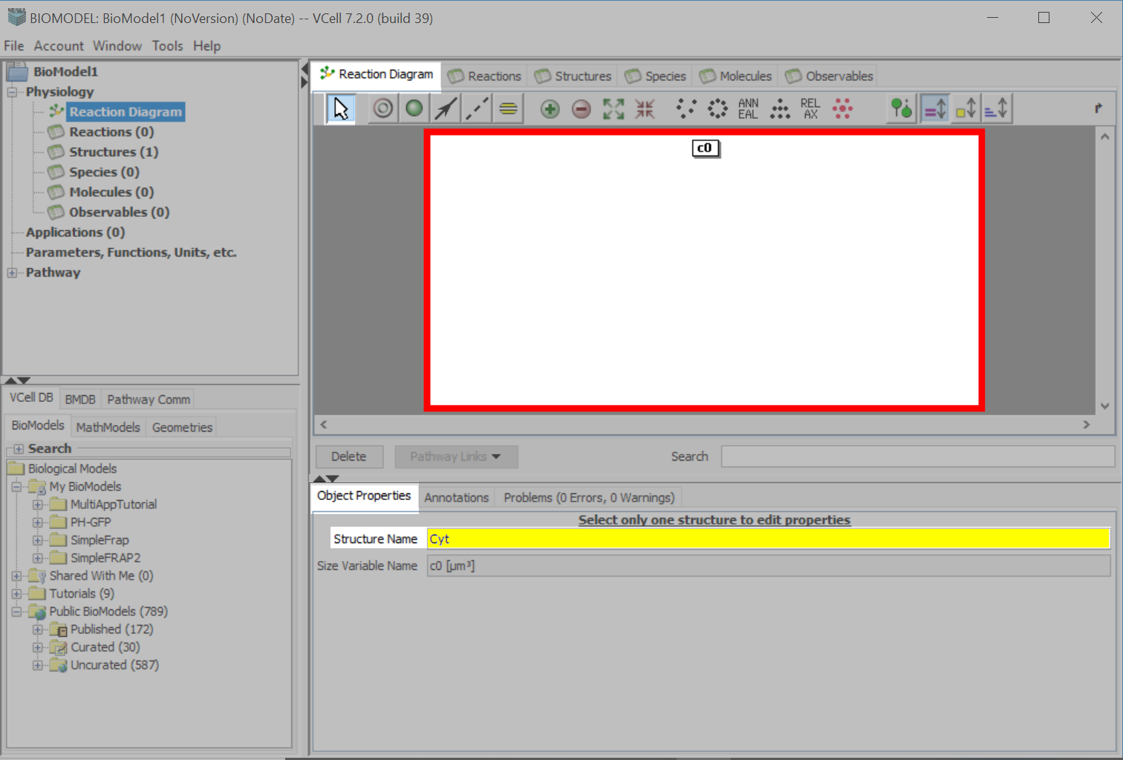
Creating a new model.
Choose the “Select” tool and select the compartment, c0.
On the “Object Properties” tab, type “Cyt” in the “Structure Name” text field. Press Enter to accept the entry.

Slide 5
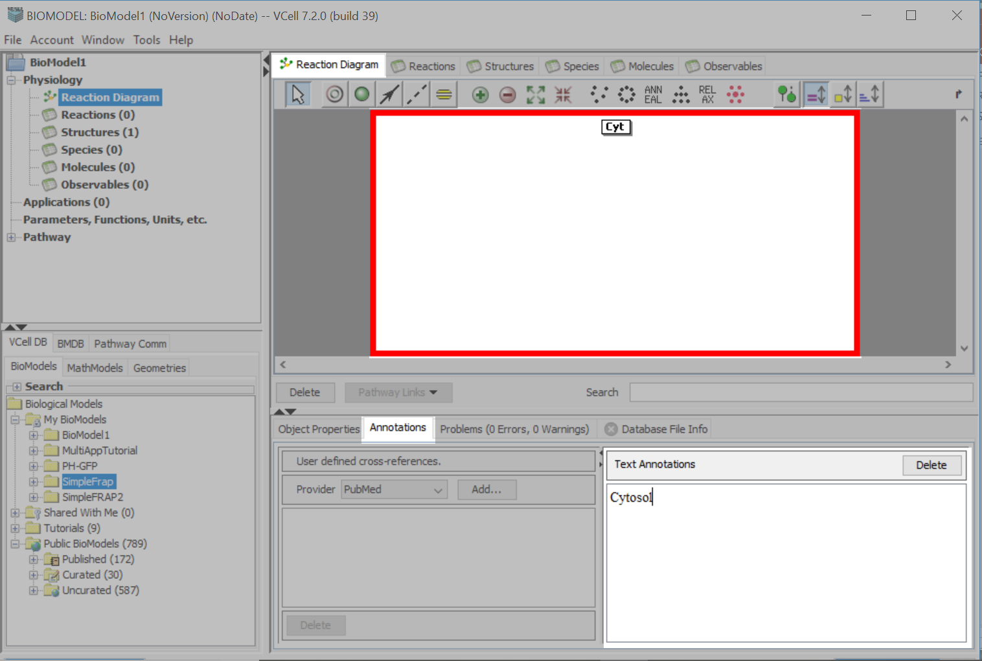
Select the “Annotations” tab and type “Cytosol” in the “Text Annotations” text box.

Slide 6
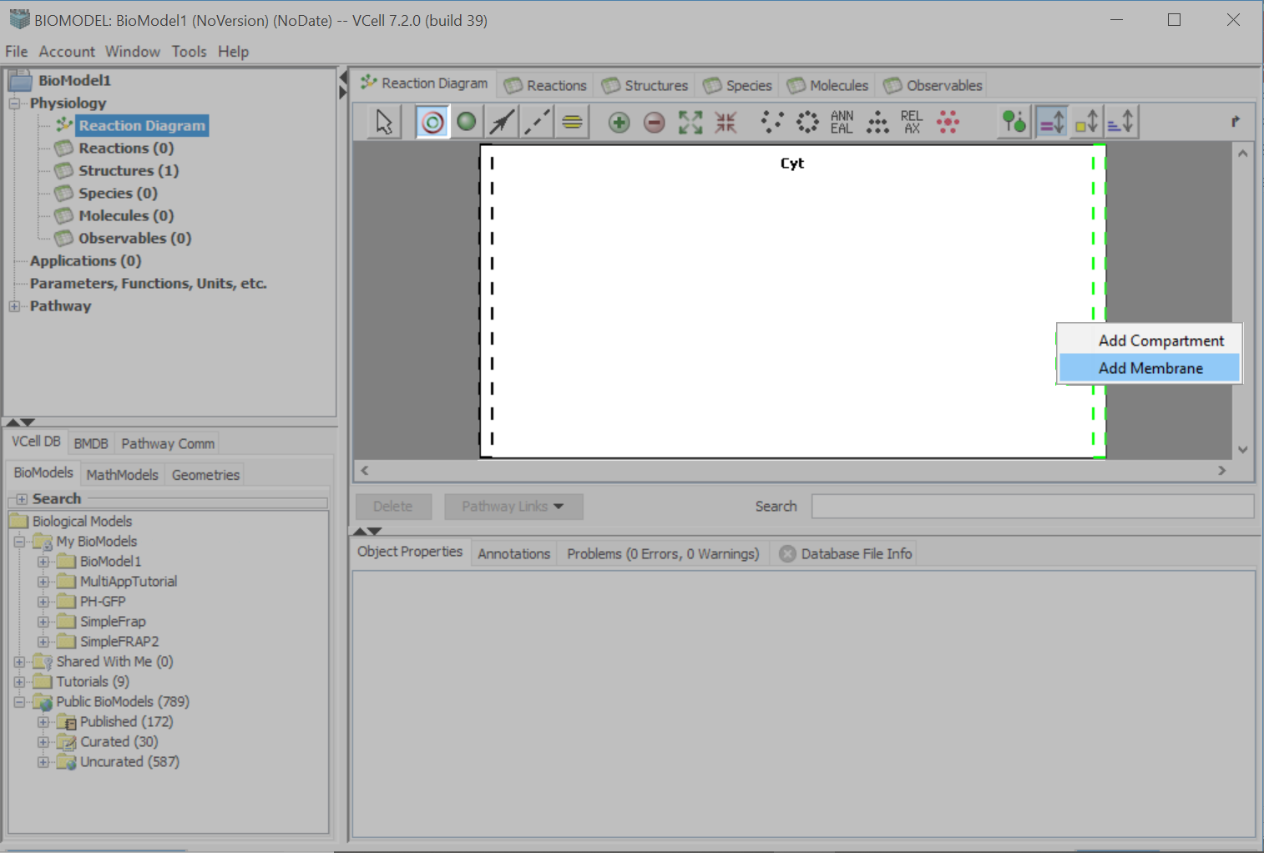
Select the “Compartment Tool”. Hover on the dotted black lines so they turn green. Click with your left mouse and select “Add Membrane”.

Slide 7
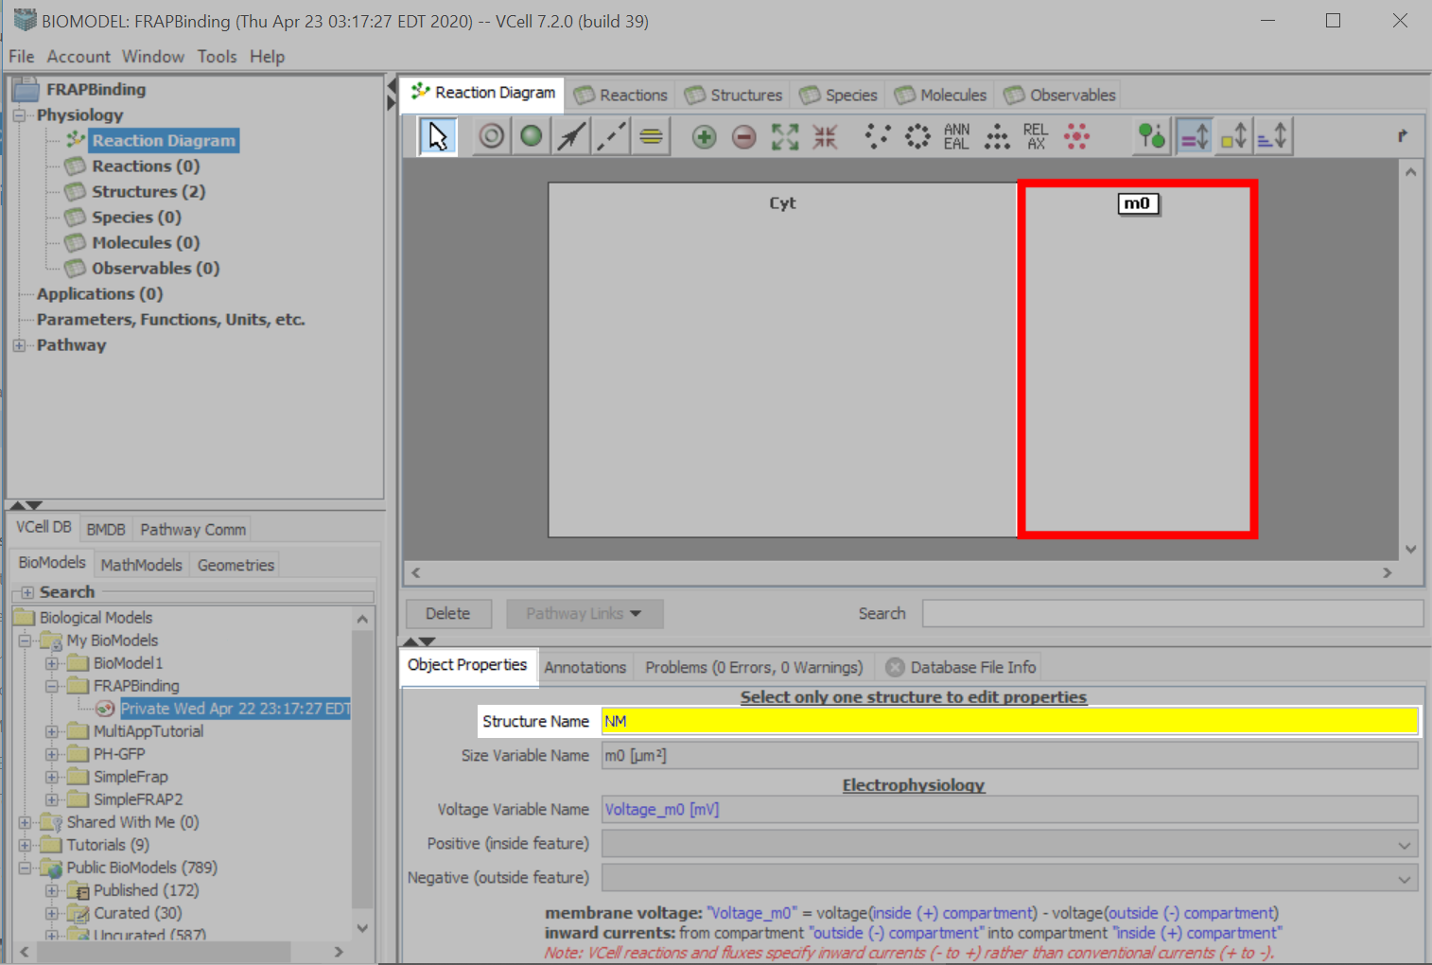
Use the “Selection Tool” to select the compartment “m0”.
On the “Object Properties” tab, type “NM”, for “Nuclear Membrane”, in the “Structure Name” text field .

Slide 8
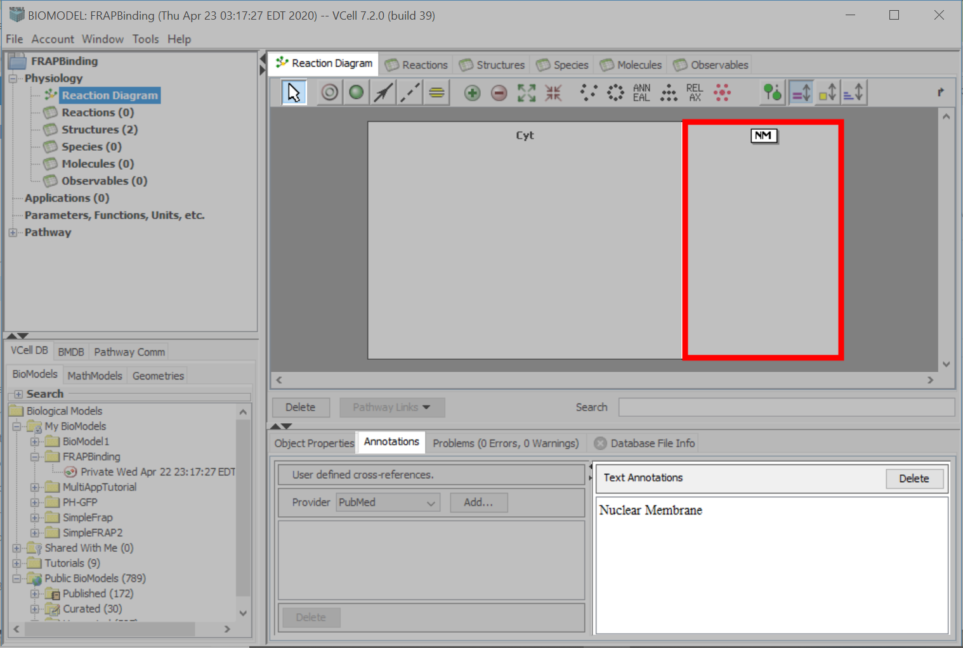
On the “Annotations” tab, type “Nuclear Membrane”, in the “Text Annotations” text field.

Slide 9
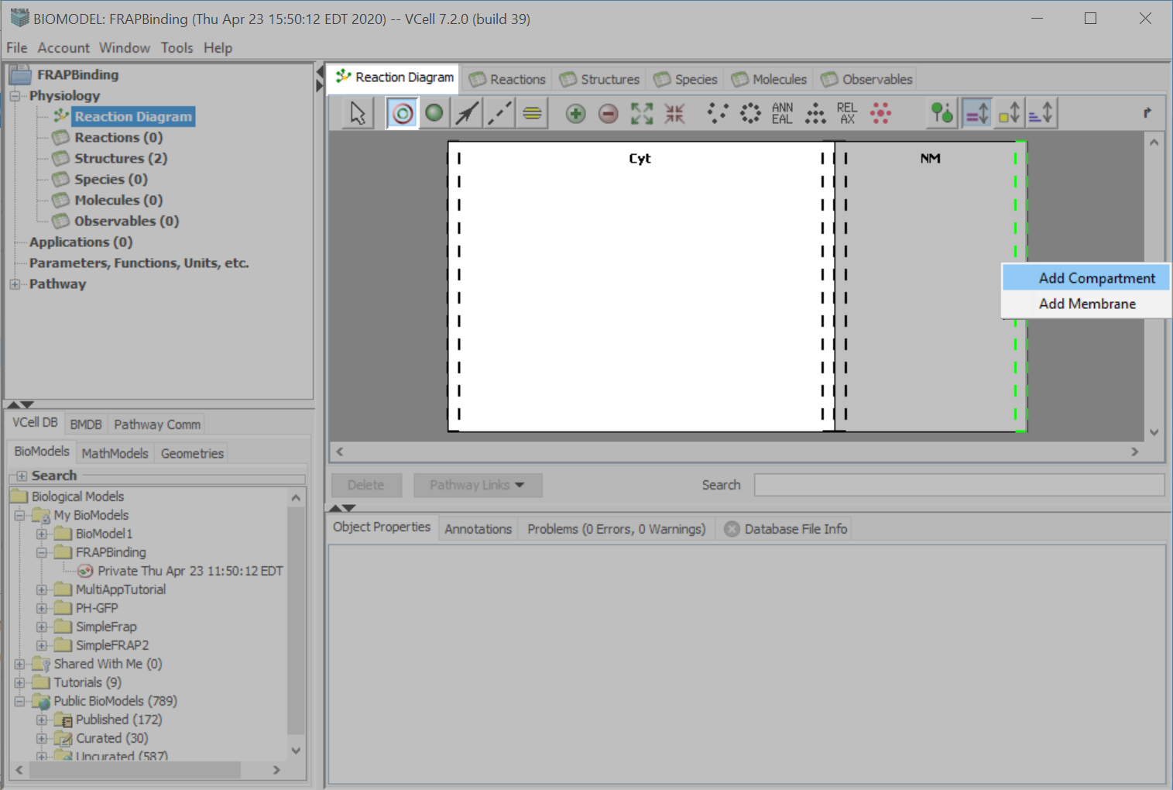
Using the “Structure Tool”, hover over the black dots, until they turn green. Use your left mouse button to select “Add Compartment”.

Slide 10
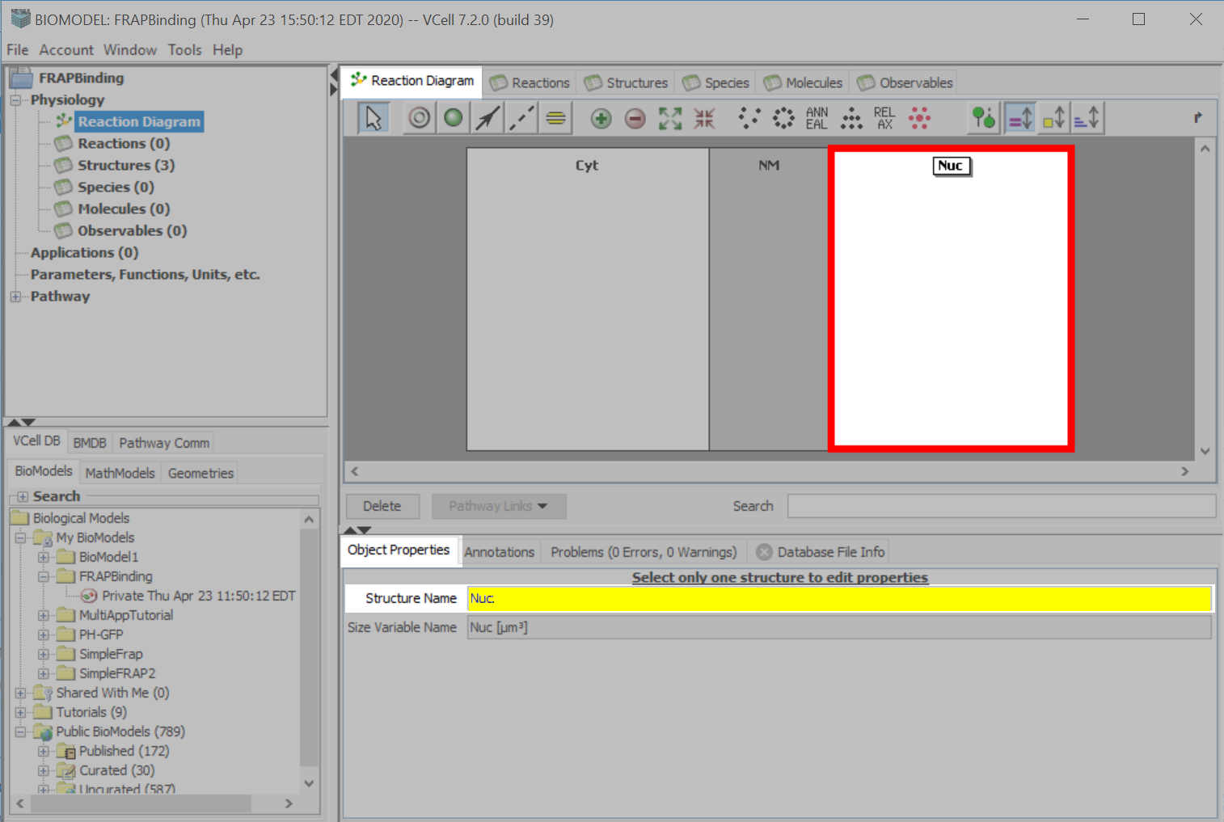
With the compartment still selected, select the “Object Properties” tab, type “Nuc” in the “Structure Name” text field.

Slide 11
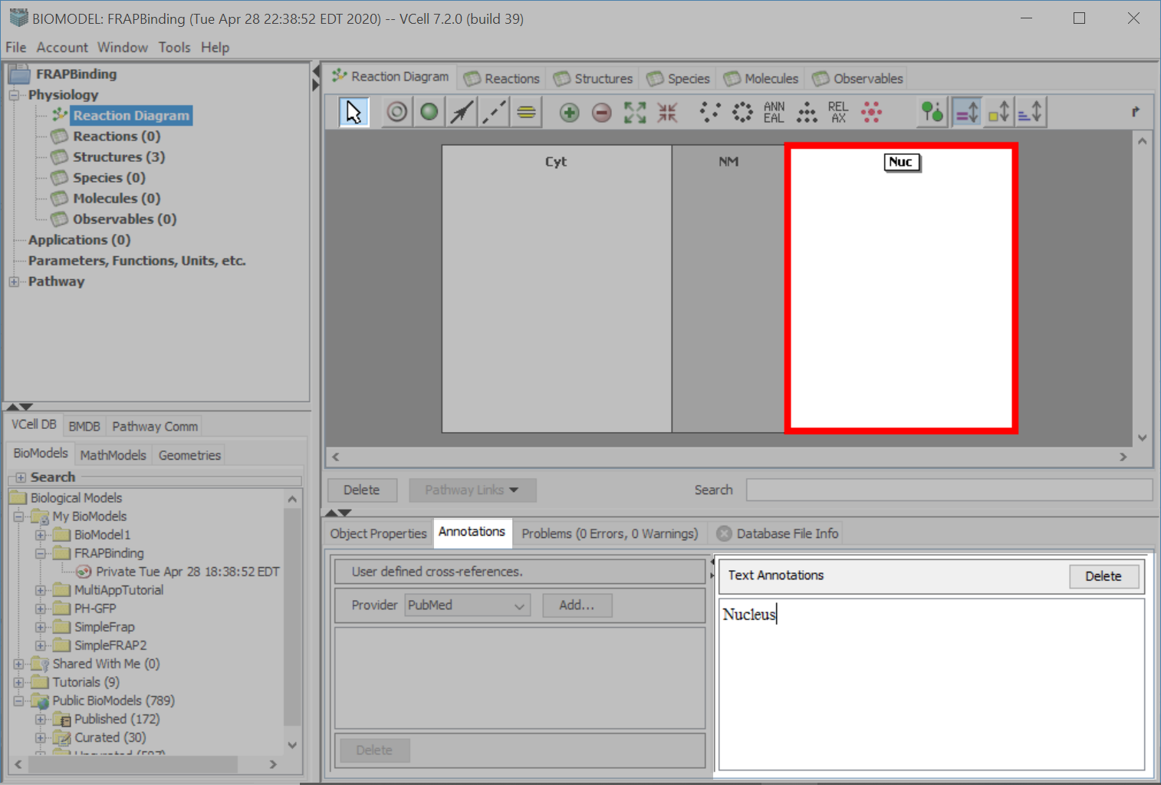
Click the “Annotations” tab and type “Nucleus” in the “Text Annotations” text box.

Slide 12
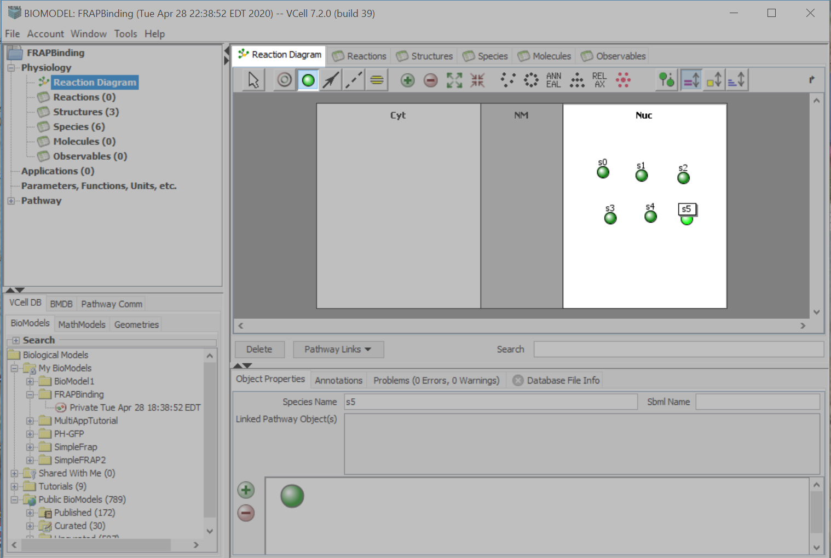
Click the “Species” tool.
Click on six different points within the “Nuc” compartment to create six different species.

Slide 13
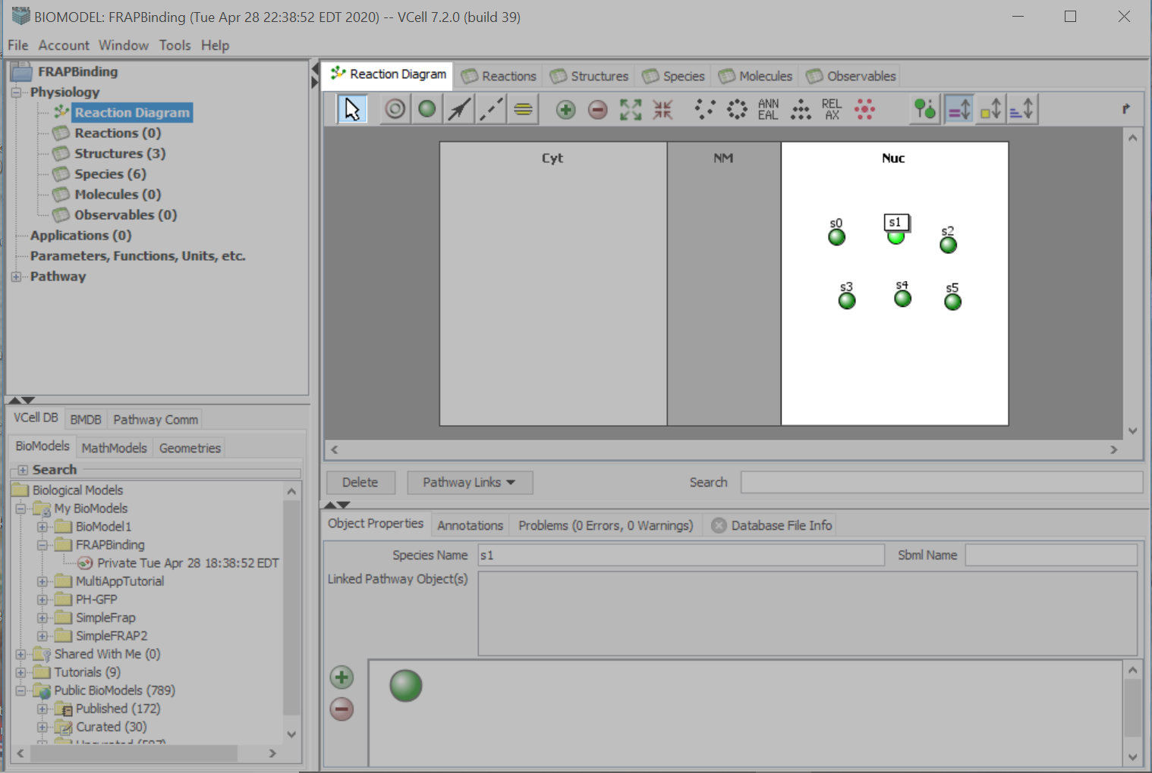
To move a species, click the “Select” tool and click and drag a species to a different area within the compartment. You cannot move an existing species to a different compartment.

Slide 14
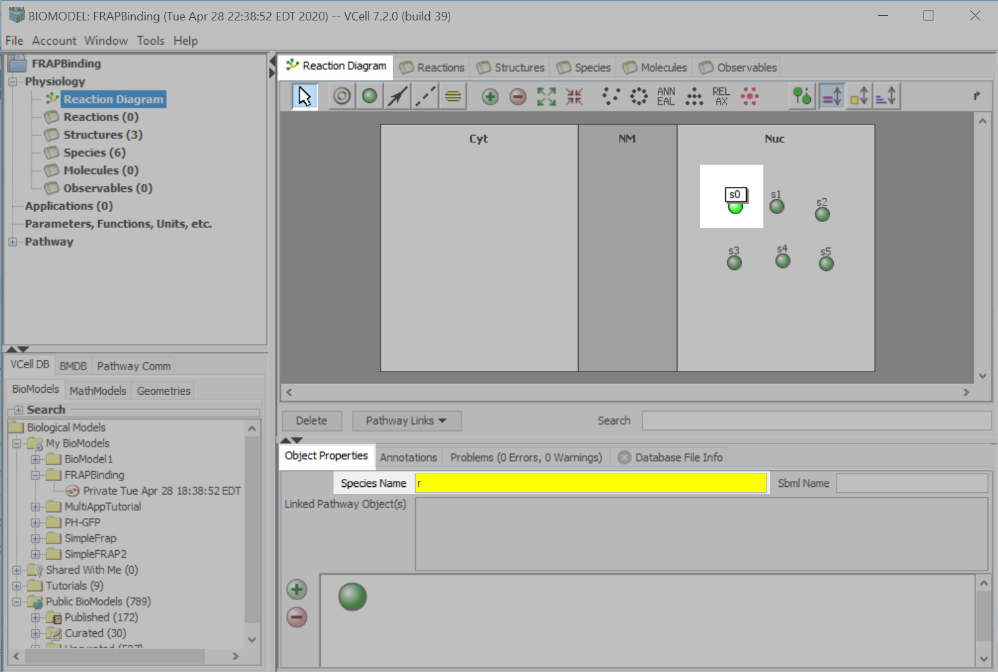
To name a “Species”, use the “Select” tool to select a single “Species”.
On the “Object Properties” tab, type in the name for the selected “Species”, in the “Species Name” text field.

Slide 15
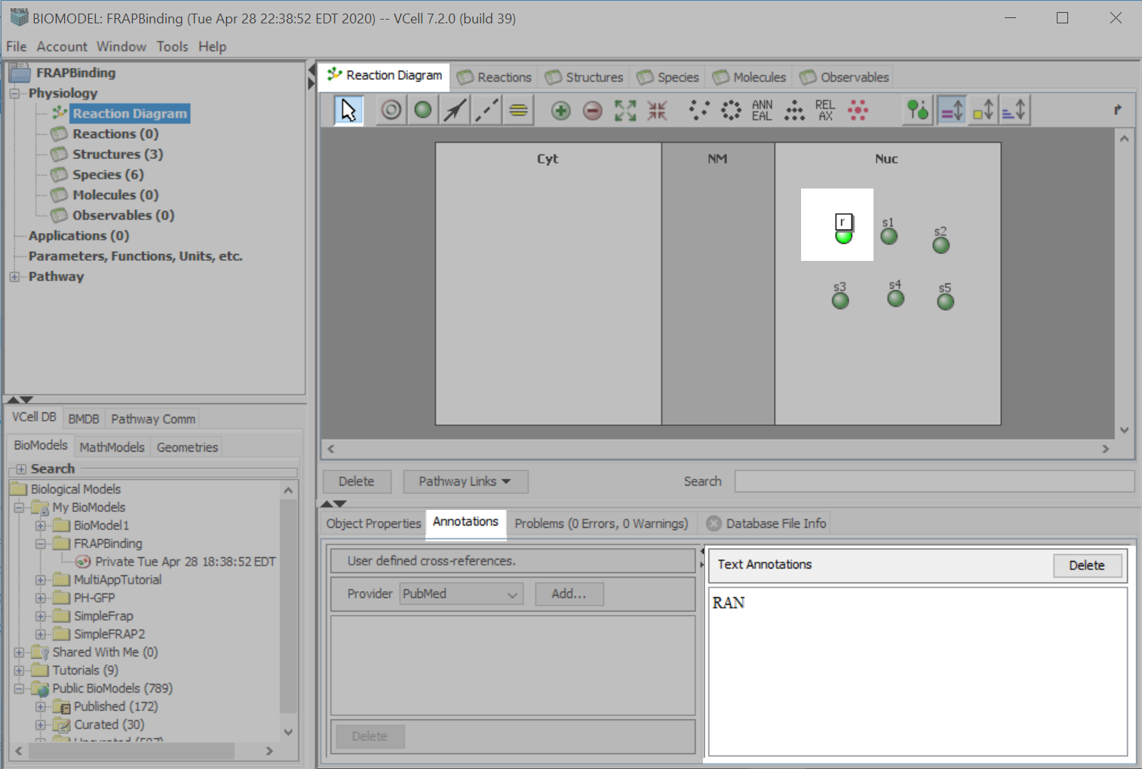
With the “Species” still active, select the “Annotations” tab and type RAN in the “Annotations Text” box.

Slide 16
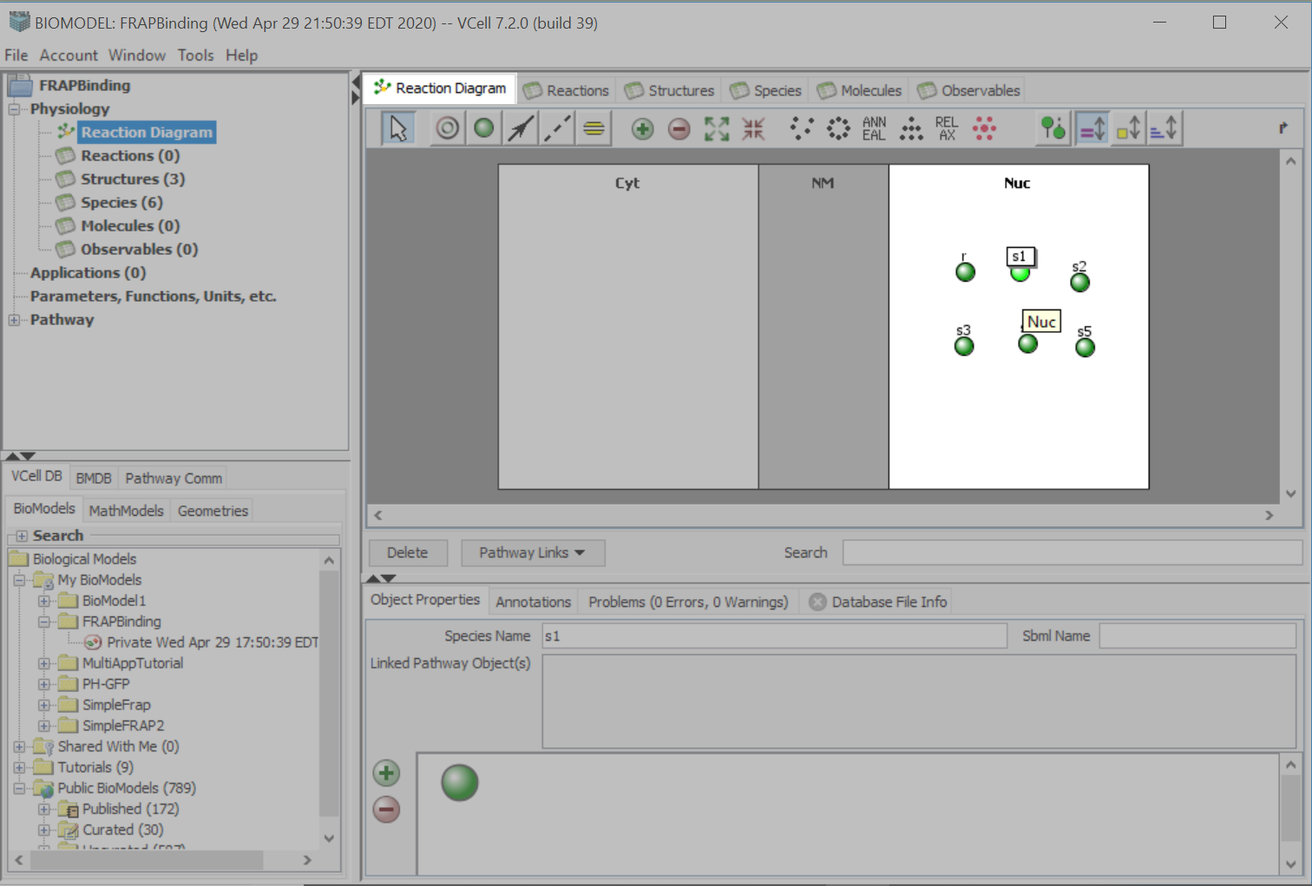
Continue to name and annotate
the species according to the table.
Species Name | Annotation
r | RAN
rf | RAN_FITC
rB | RAN_Bound
BS | Binding Sites
rfB | RAN_FITC_Bound
Laser | Light Source
With the “Species” still active, select the “Annotations” tab and type RAN in the “Annotations Text” box.

Slide 17
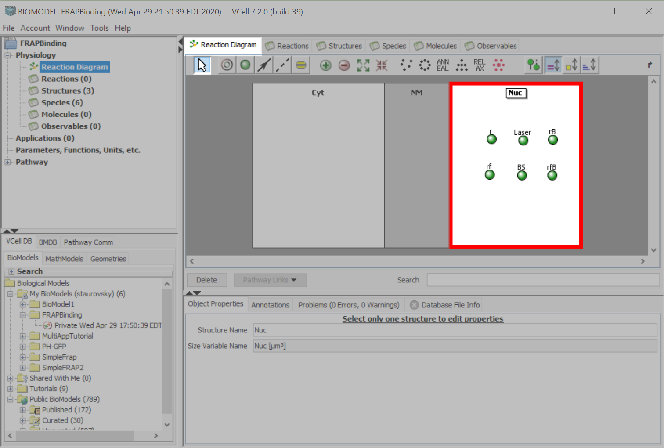
Using the “Select” tool, click and drag the species so that the order reflects the nuclear compartment, as pictured.

Slide 18
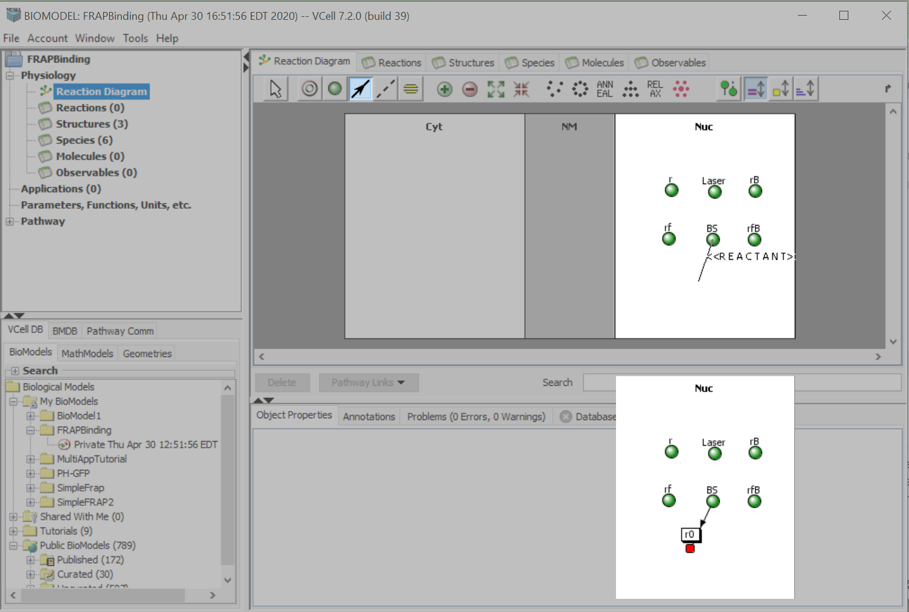
Select the “Reaction Connection” tool.
Click on “BS” and drag your cursor, which will create a line marked <<REACTANT>>.
Drop your cursor anywhere inside the “Nuc” compartment.
You will create the reaction node, “r0”, upon release of your mouse.

Slide 19
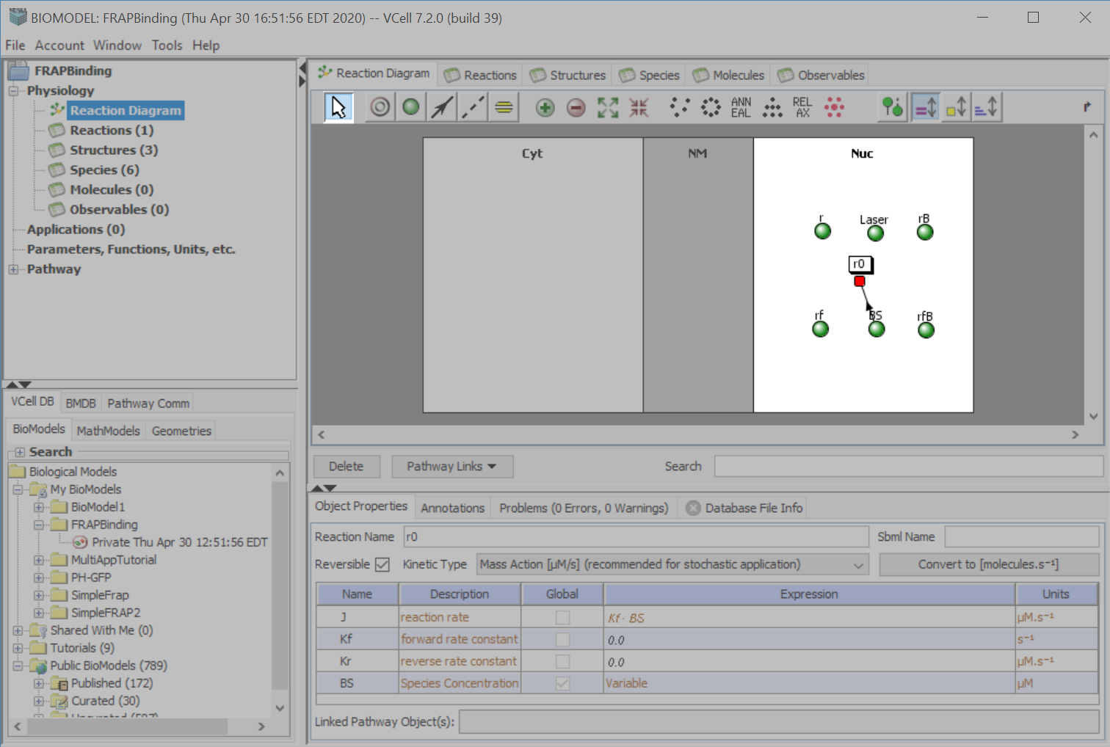
Using the “Select” tool, click and drag “r0” to move it within the compartment.

Slide 20
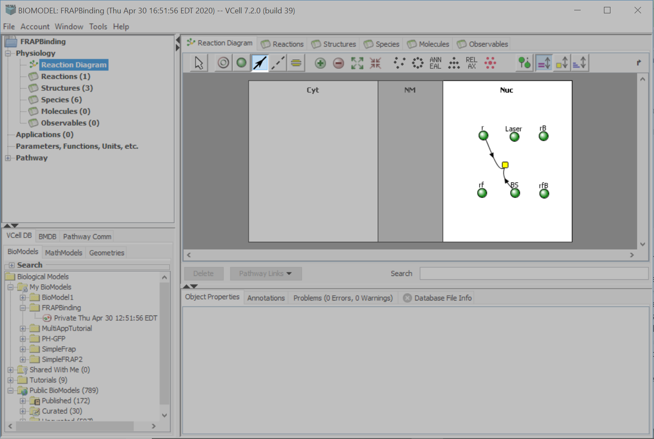
Use the “RX Connection” tool to drag a line from “r” to the “r0” reaction node.

Slide 21
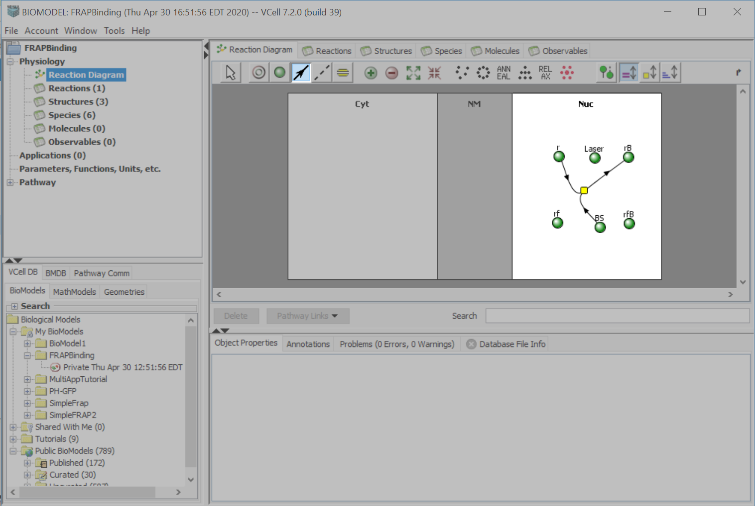
Using the “RX Connection” tool, drag a line from “r0” to “rB”.

Slide 22
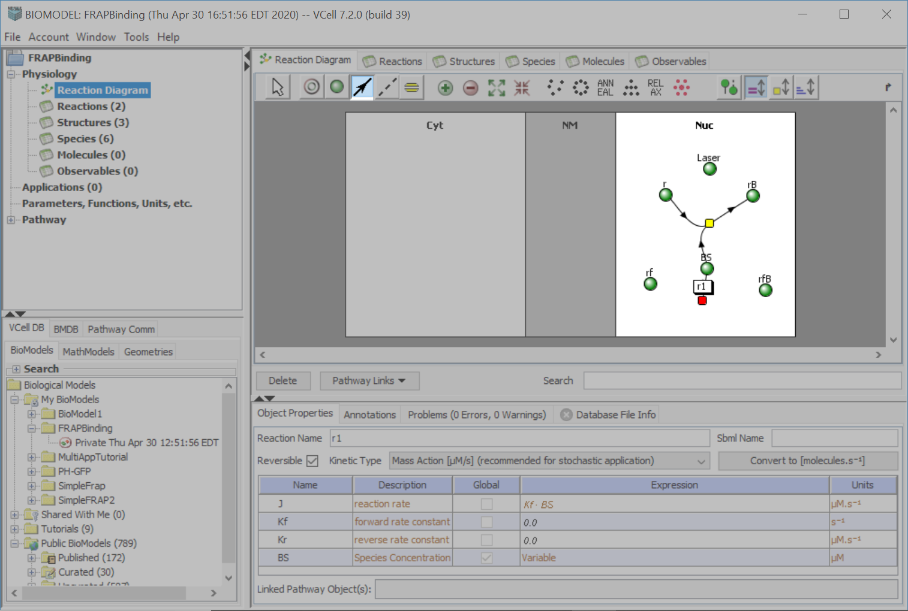
Using the “RX Connection” tool, click on “BS” and drag your cursor to another point in the “Nuc” compartment.
You will create a reaction node called “r1”.
Adjust its position using the “Select” tool.

Slide 23
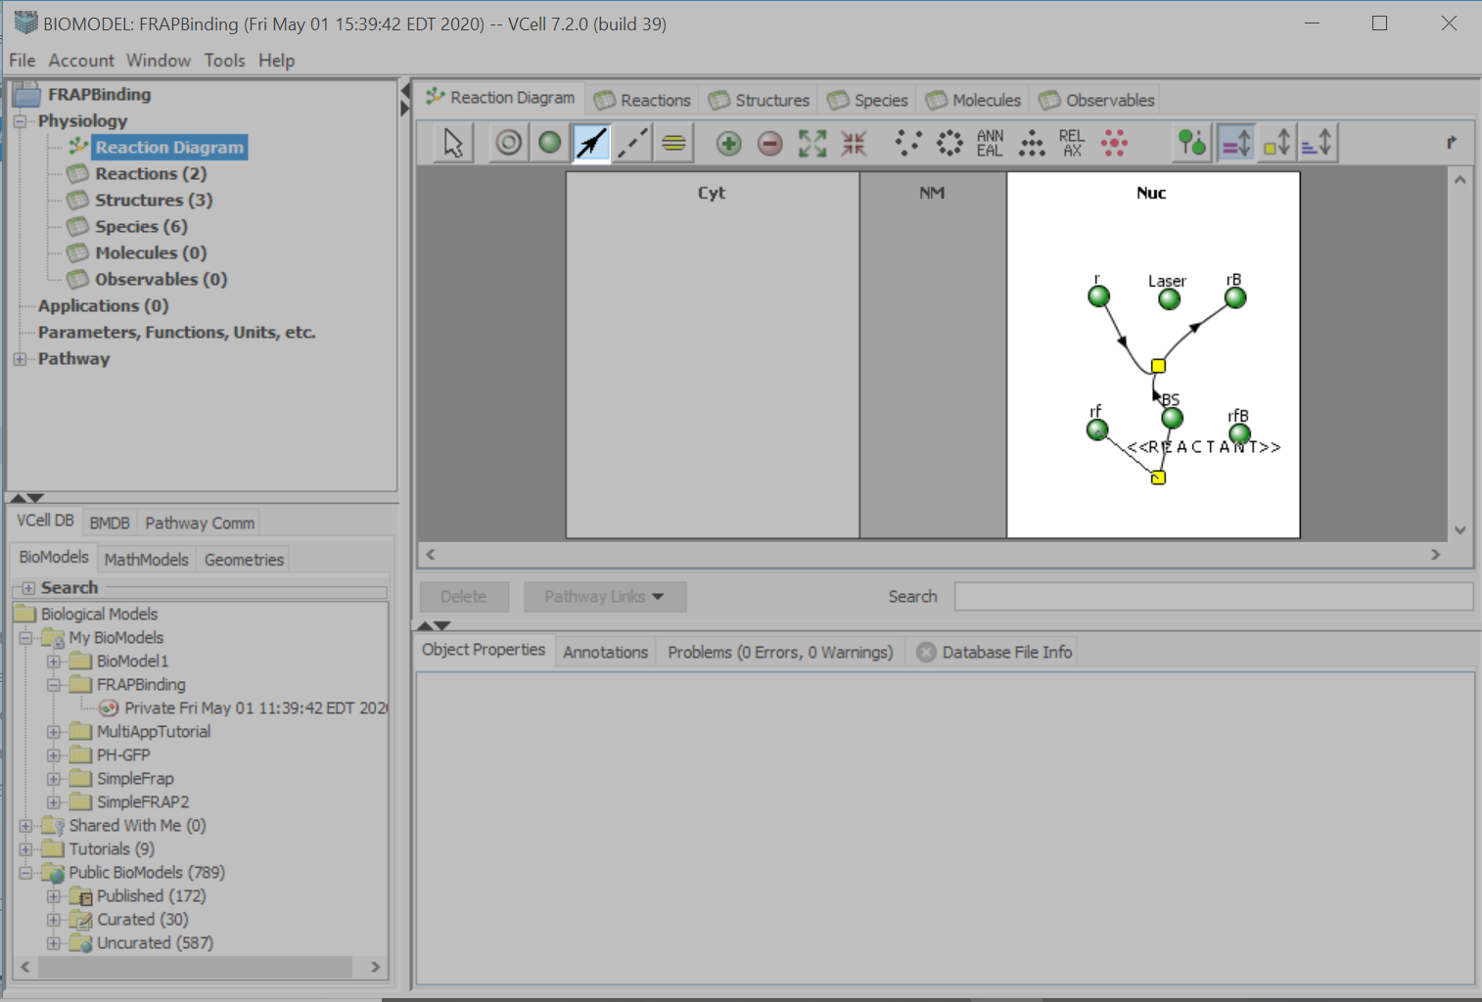
Using the RX Connection tool, drag a line from “rf” to “r1”.

Slide 24
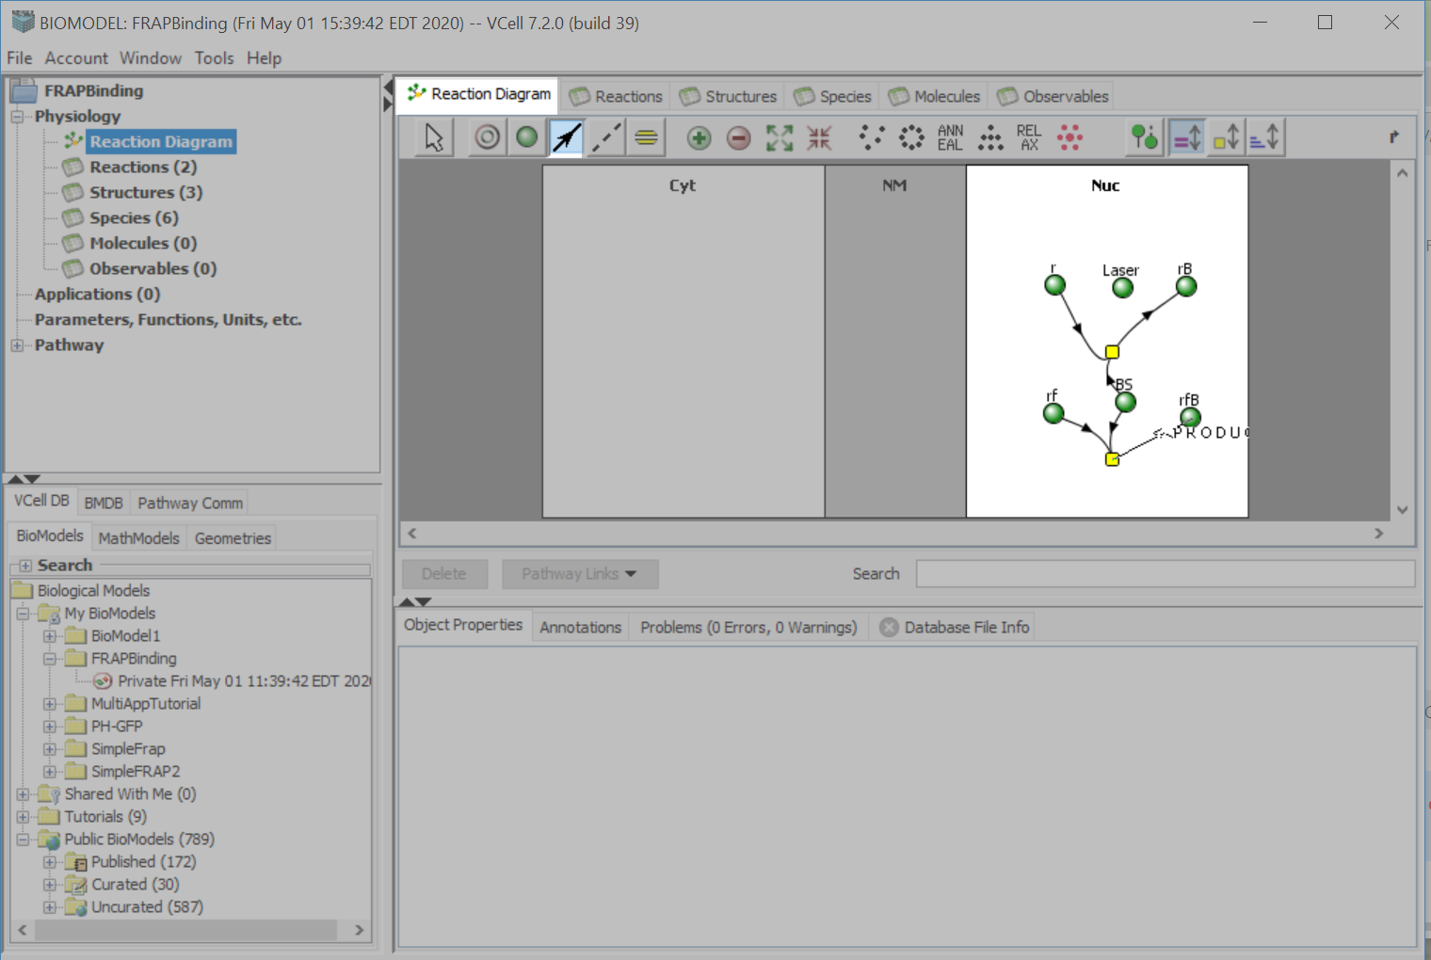
Using the “RX Connection” tool, drag a line from “r1” to “rfB”.

Slide 25
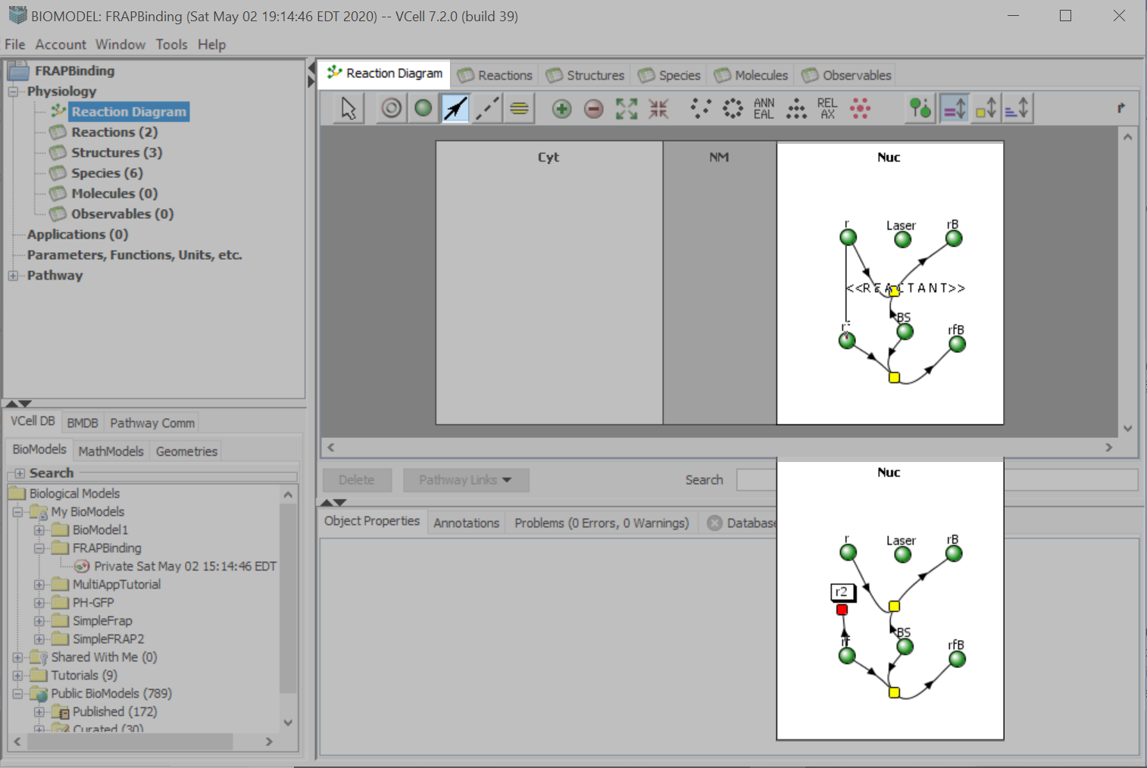
Using the “RX Connection” tool, drag your cursor from “rf” to somewhere within the “Nuc” compartment.
You will create reaction node “r2”.

Slide 26
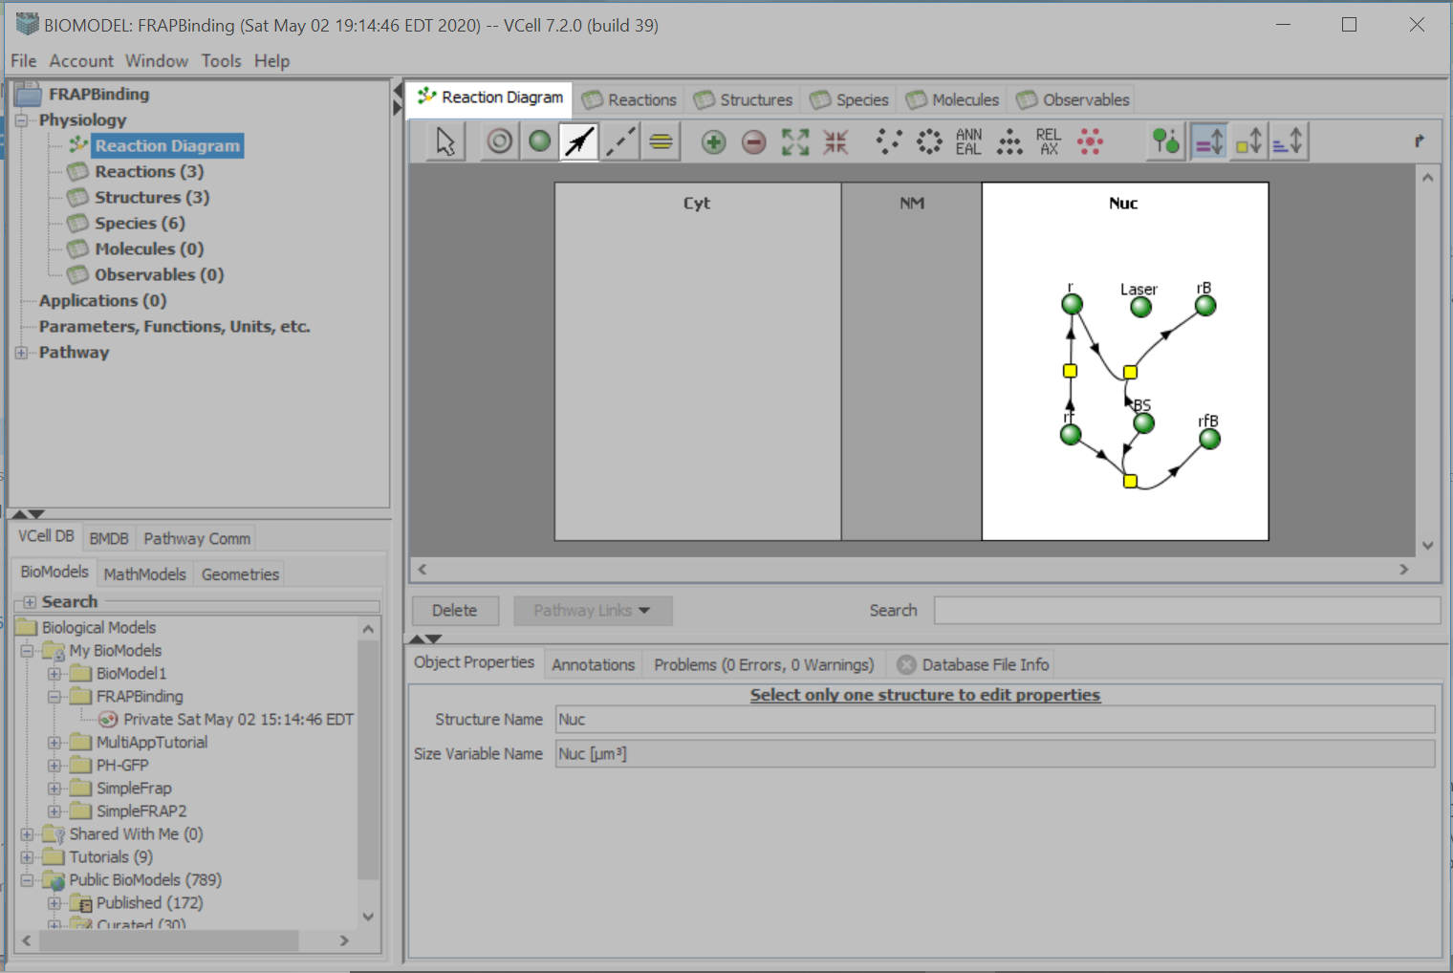
Using the “RX Connection” tool, drag from “r2” to “r”.
This will complete the reaction between “rf” and “r”.

Slide 27
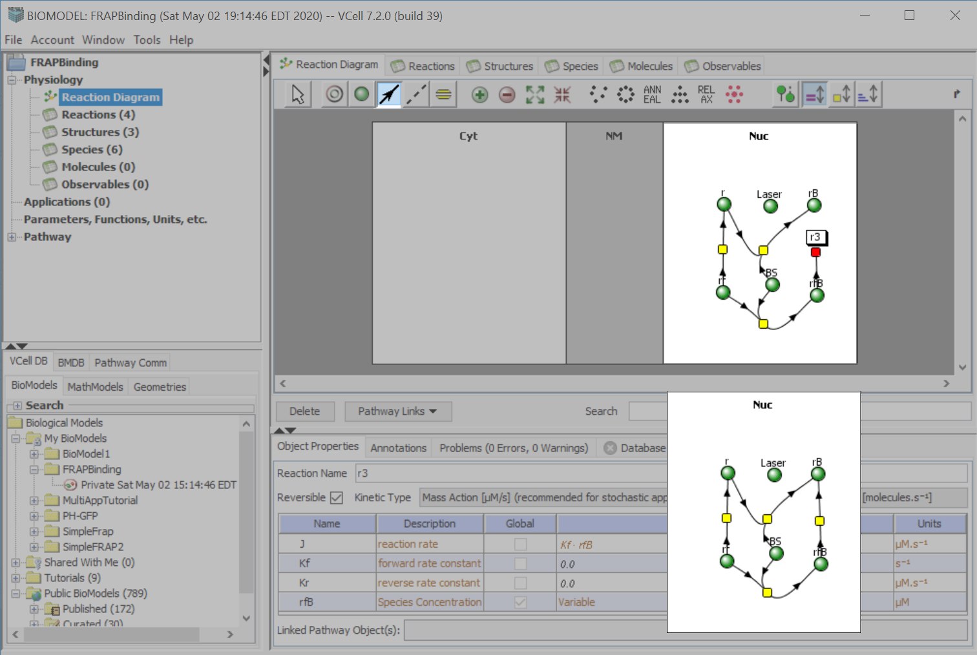
Using the “RX Connection” tool, drag your cursor from “rfB”, to somewhere within the “Nuc” compartment.
This will create reaction node “r3”.
With the “RX Connection” tool, drag from “r3” to “rB”.
This completes the reaction between “rfB” and “rB”.

Slide 28
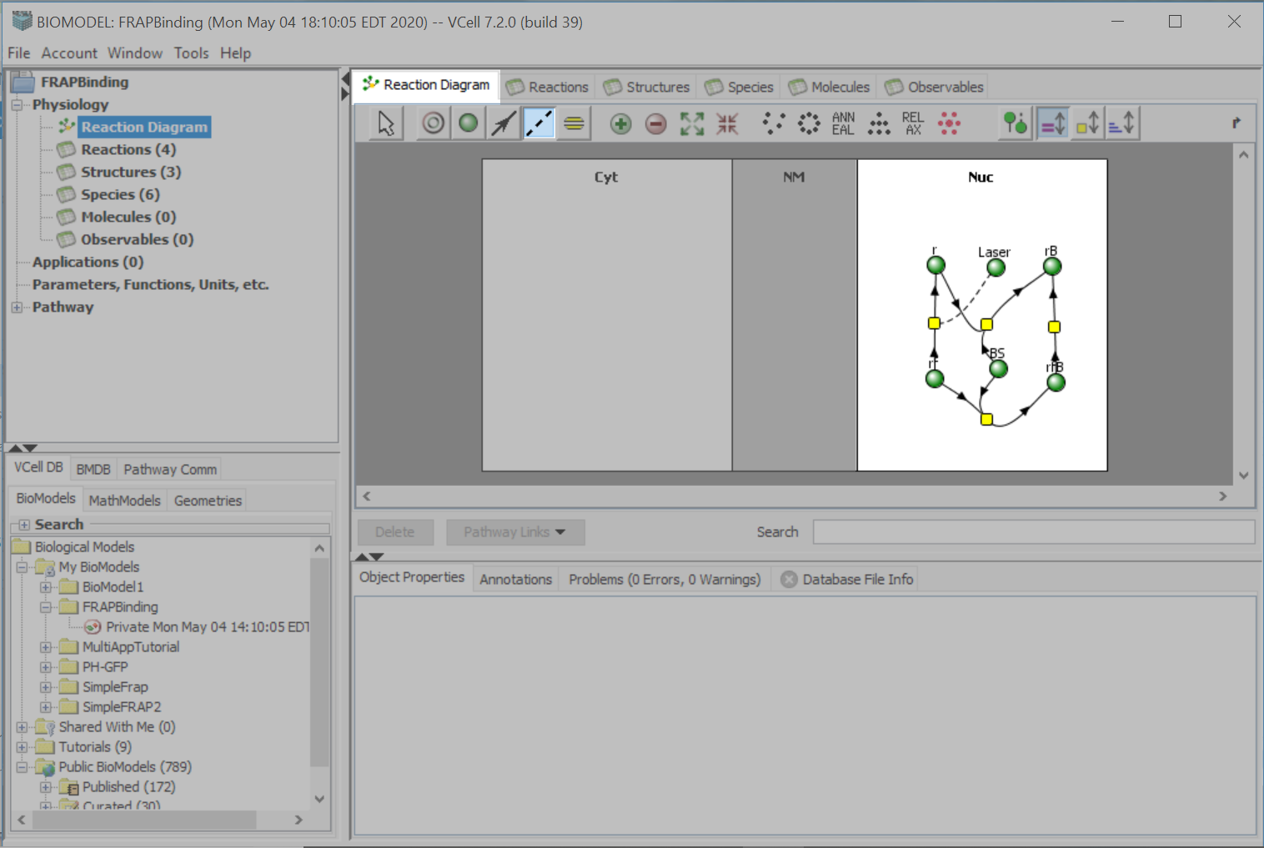
Using the “Catalyst” tool, click on “r2” and drag your cursor to the “Laser” species.

Slide 29
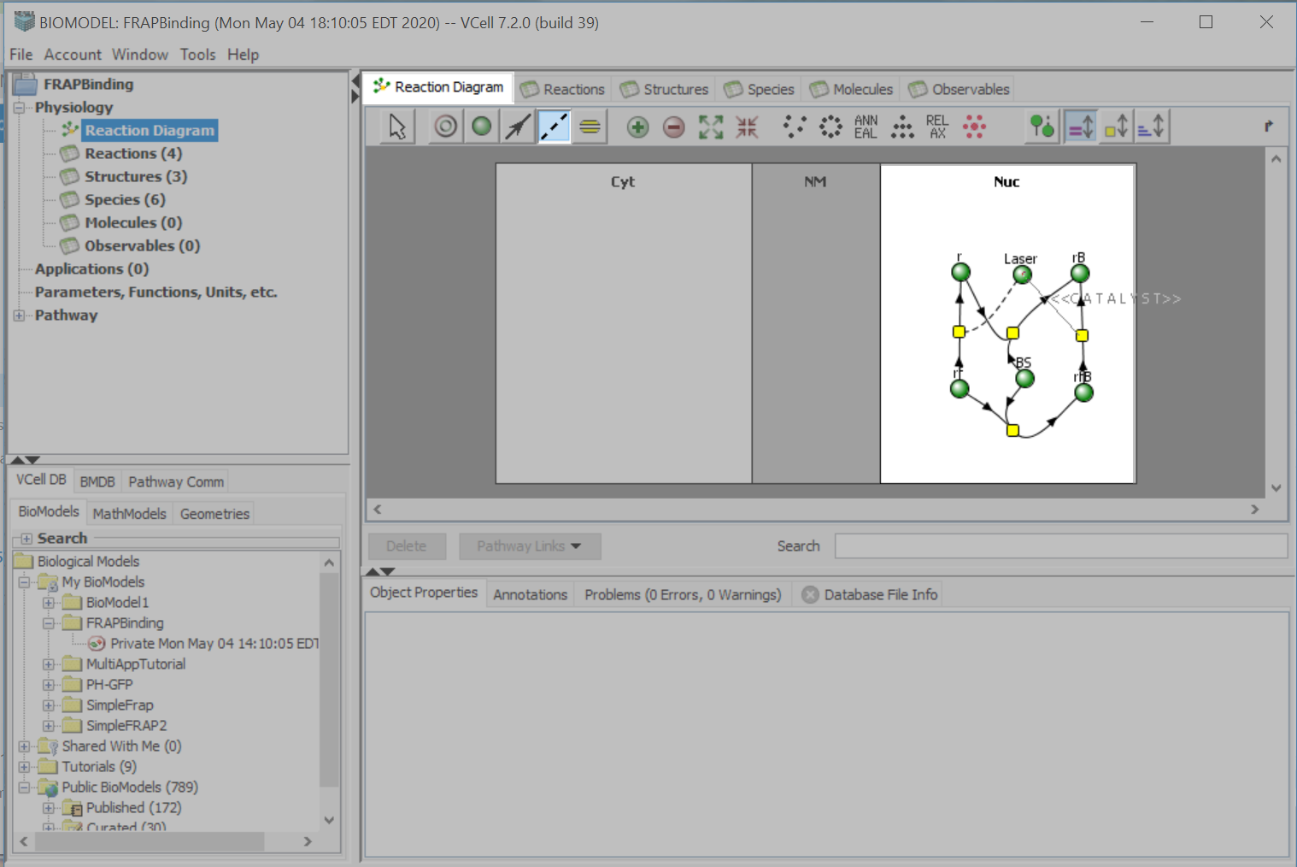
Using the “Catalyst” tool, drag a line from the “Laser” species to “r3”.

Slide 30
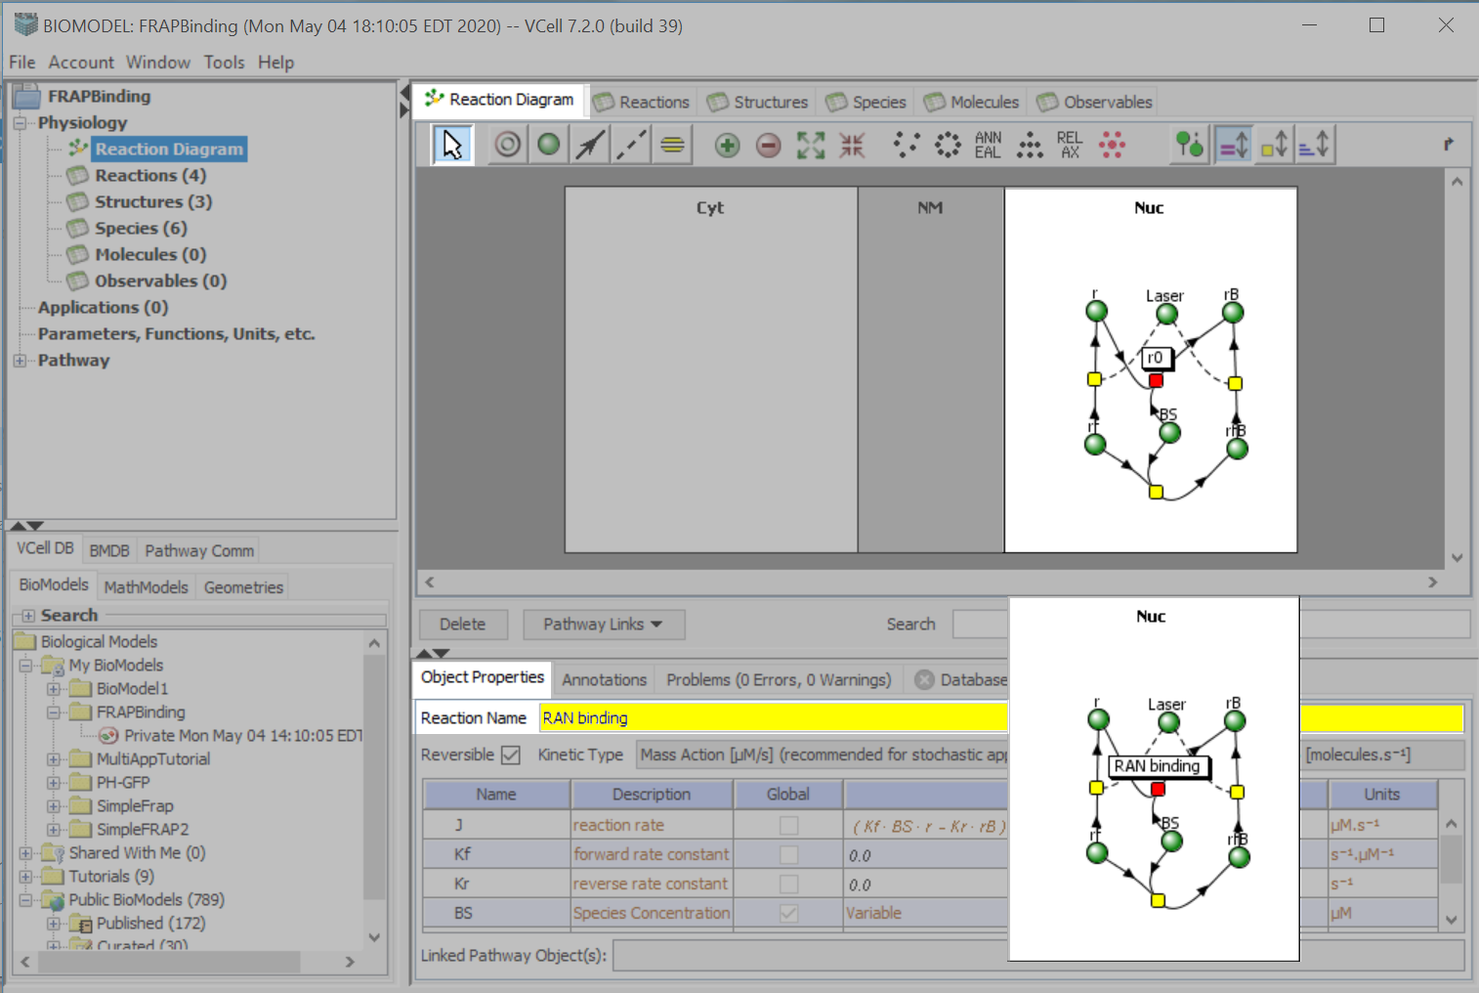
Use the “Select” tool to click on “r0”.
Select the “Object Properties” tab.
Type “RAN” binding, in the “Reaction Name” text field.

Slide 31
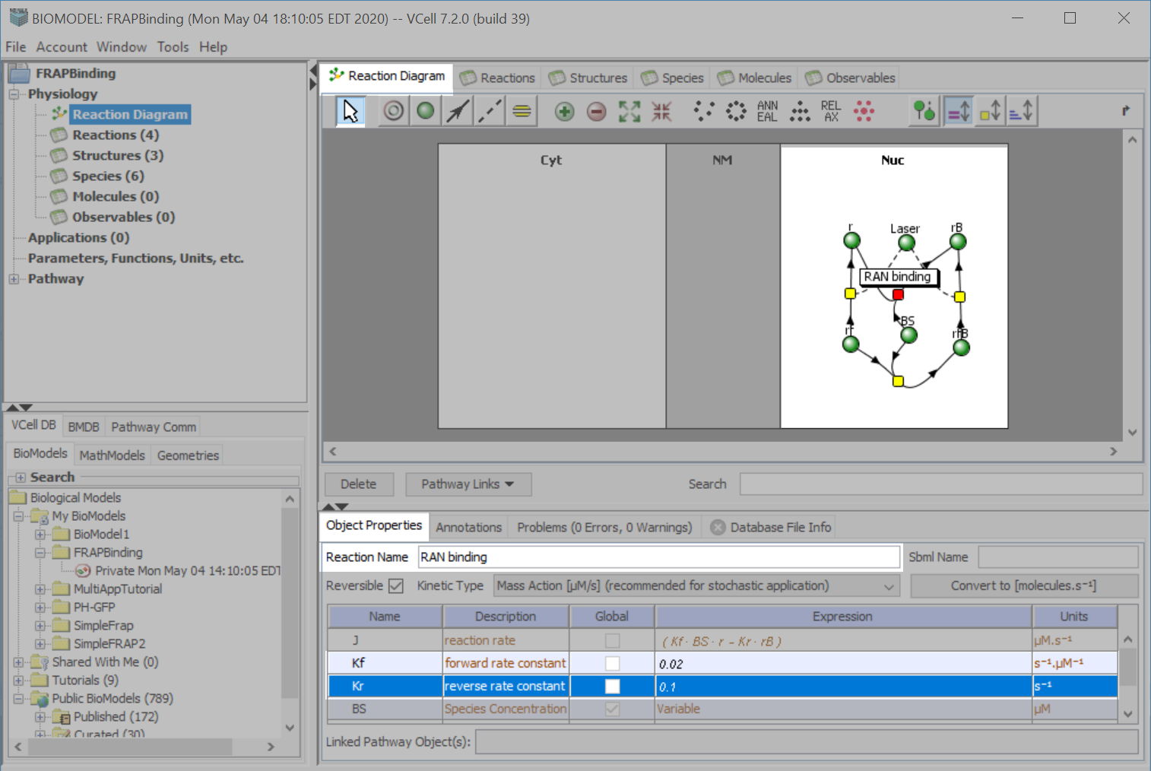
Use the “Select” tool to click the “RAN binding” reaction node.
In the “Expression” column, type “.02” in the “forward rate constant” text field.
Type “.1” in the “reverse rate constant” text field. Press “Enter” on your keyboard to accept your entries.

Slide 32
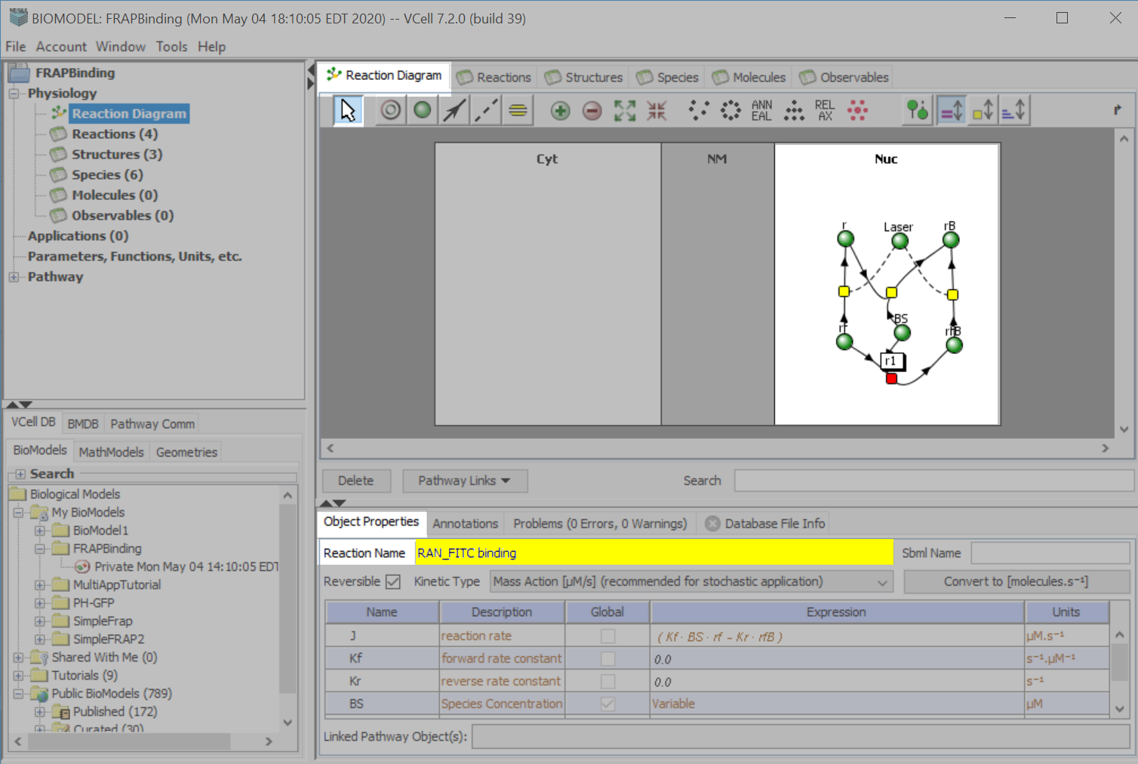
Use the “Select” tool to click on “r1”.
On the “Object Properties” tab, in the “Reaction Name” text field, type “RAN_FITC binding”.

Slide 33
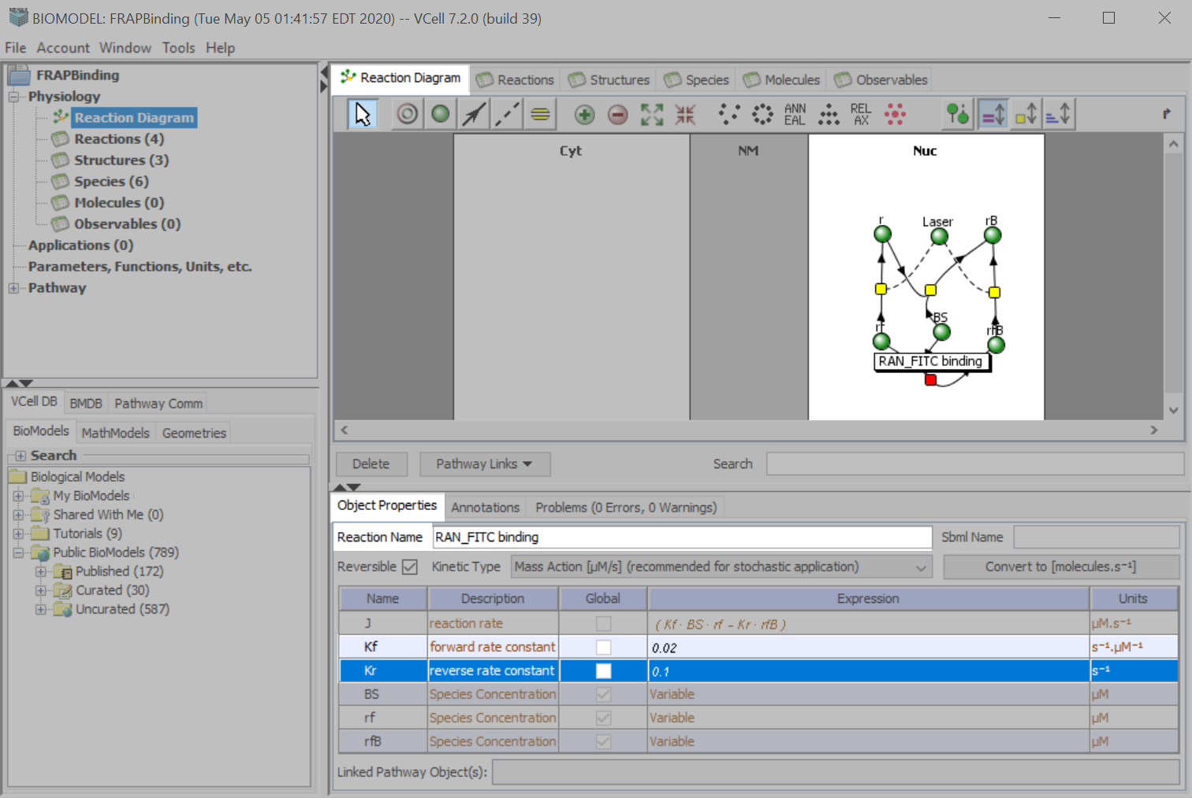
In the “Expression” column, type “.02” in “forward rate constant” text field and type “.1” in the “reverse rate constant” text field. Press “Enter” on your keyboard to accept your entries.

Slide 34
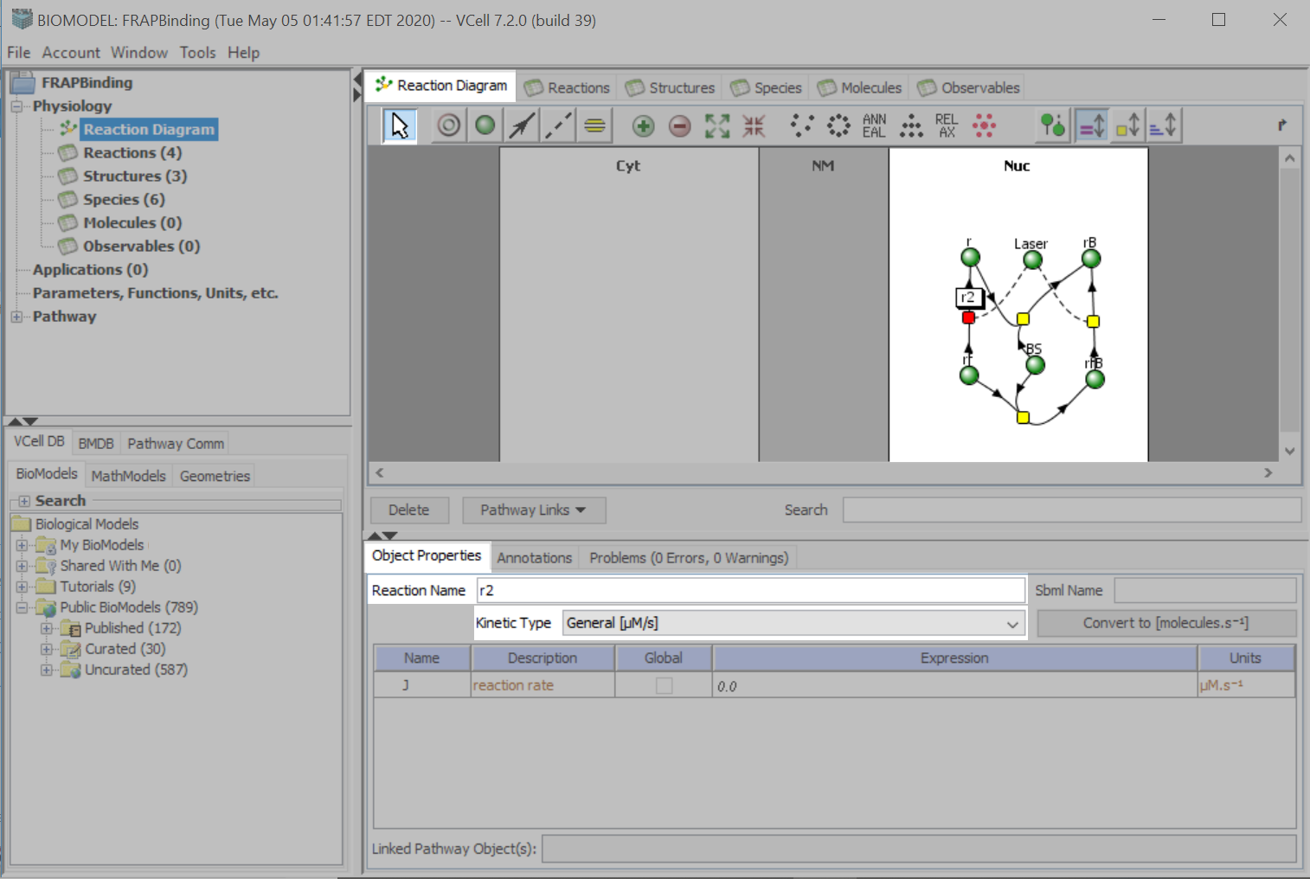
Using the “Select” tool, click the “r2” node.
Click the drop down menu next to “Kinetic Type”, and select “General [μM/s]”.

Slide 35
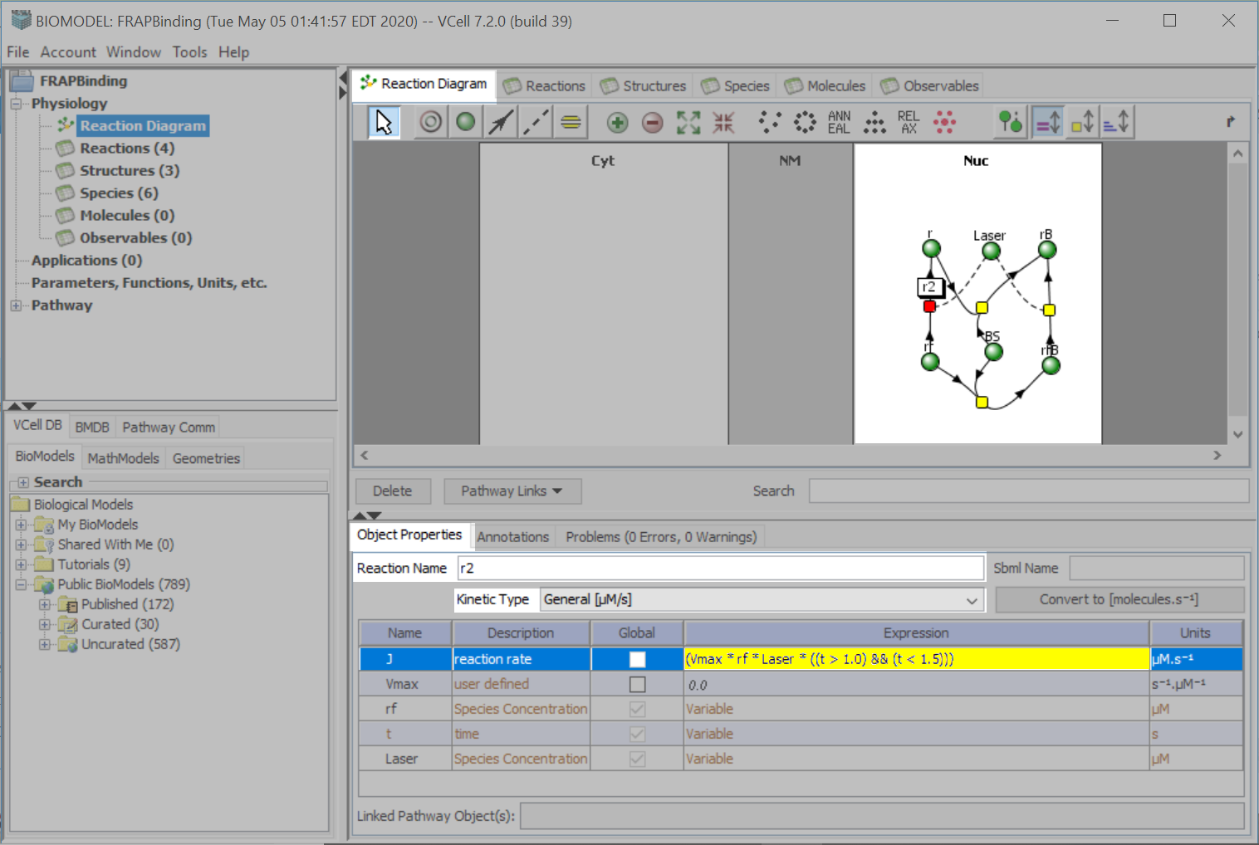
Ensure the “r2” node is still selected.
Under the Expression column, in the “reaction rate” text field, type:
“(Vmax*rf*Laser*((t>1.0)&&(t<1.5)))”.
Press “Enter” on your keyboard to accept your entry.
The Boolean expression evaluates to 1 during the time interval from 1.0 to 1.5 secs; at other times, the expression evaluates to 0 so the bleaching reactions only occur during the specified time interval.

Slide 36
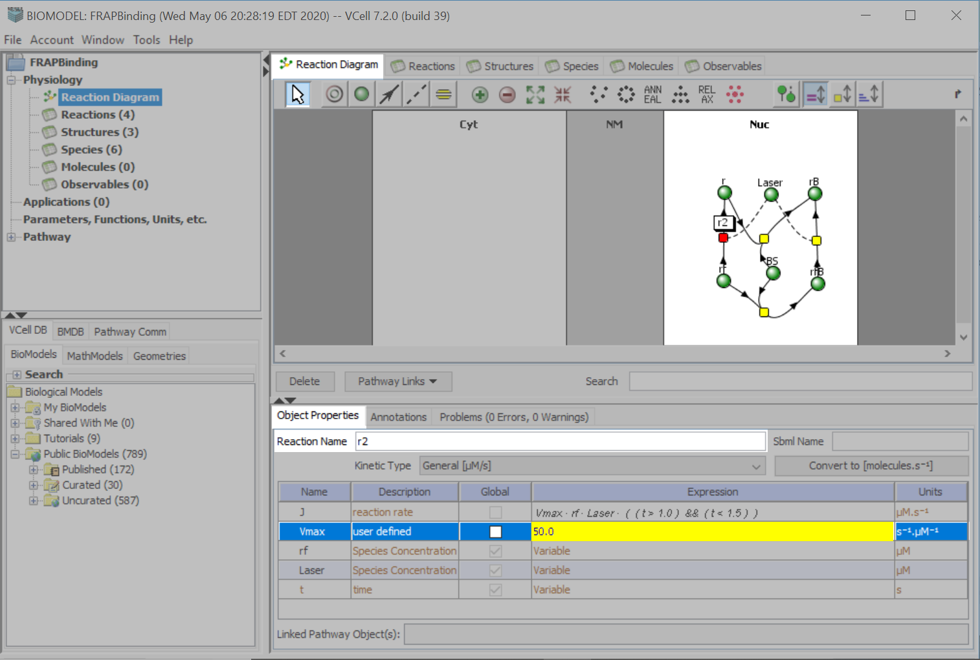
Ensure the “r2” node is still selected.
Under the “Expression” column, in the Vmax text field, type “50”.
Press “Enter” on your keyboard to accept your entry.

Slide 37
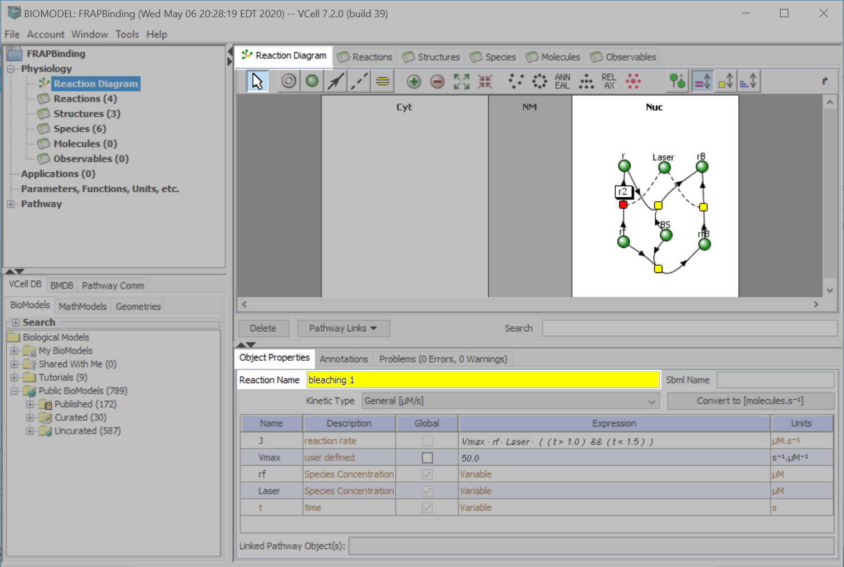
Ensure the “r2” node is still selected.
In the “Reaction Name” text field, type “bleaching 1”.

Slide 38
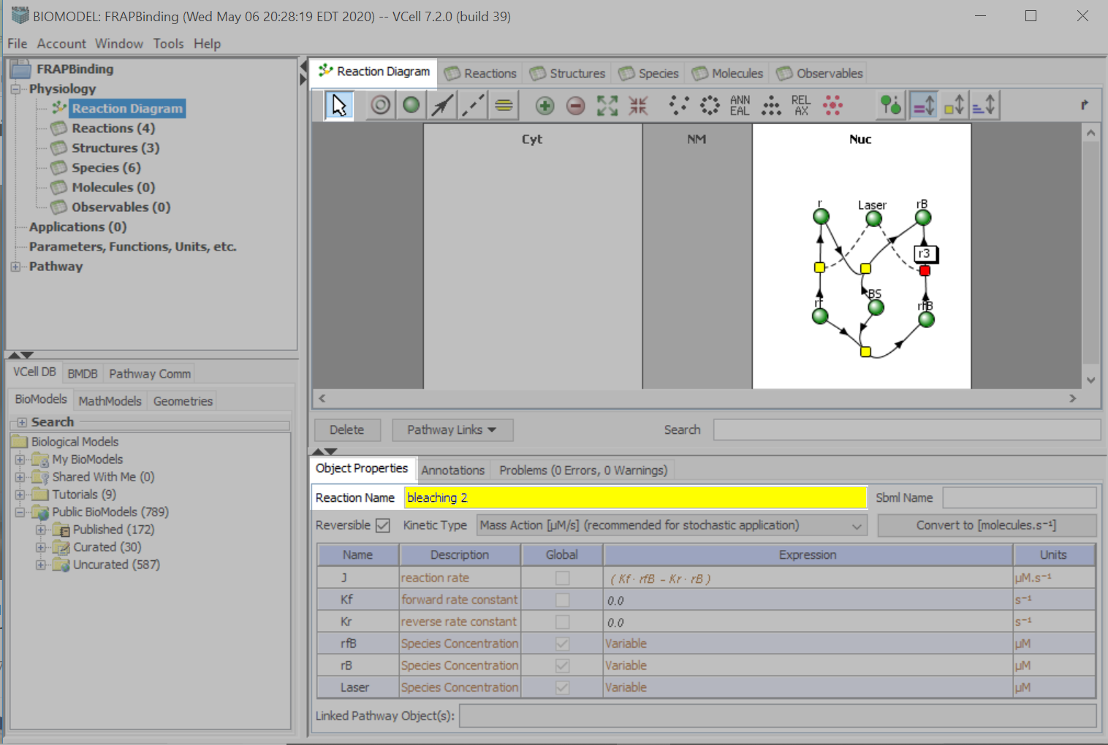
Use the “Select” tool to click on node “r3”.
In the “Reaction Name” text field, type “bleaching 2”.

Slide 39
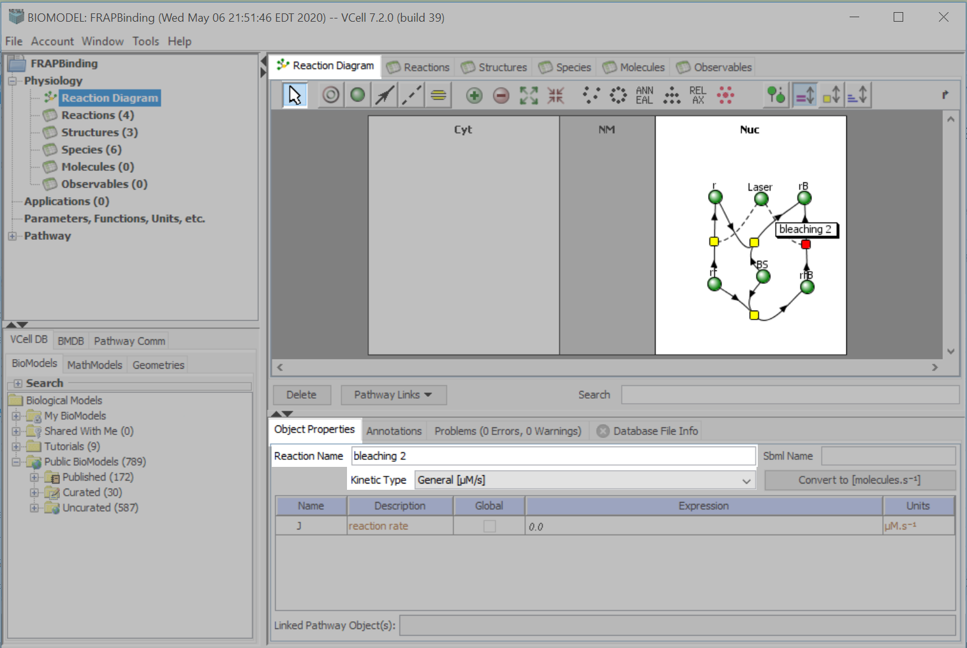
Ensure that the “bleaching 2” node is still selected.
Click the drop down menu next to “Kinetic Type” and select “General [μM/s]”.

Slide 40
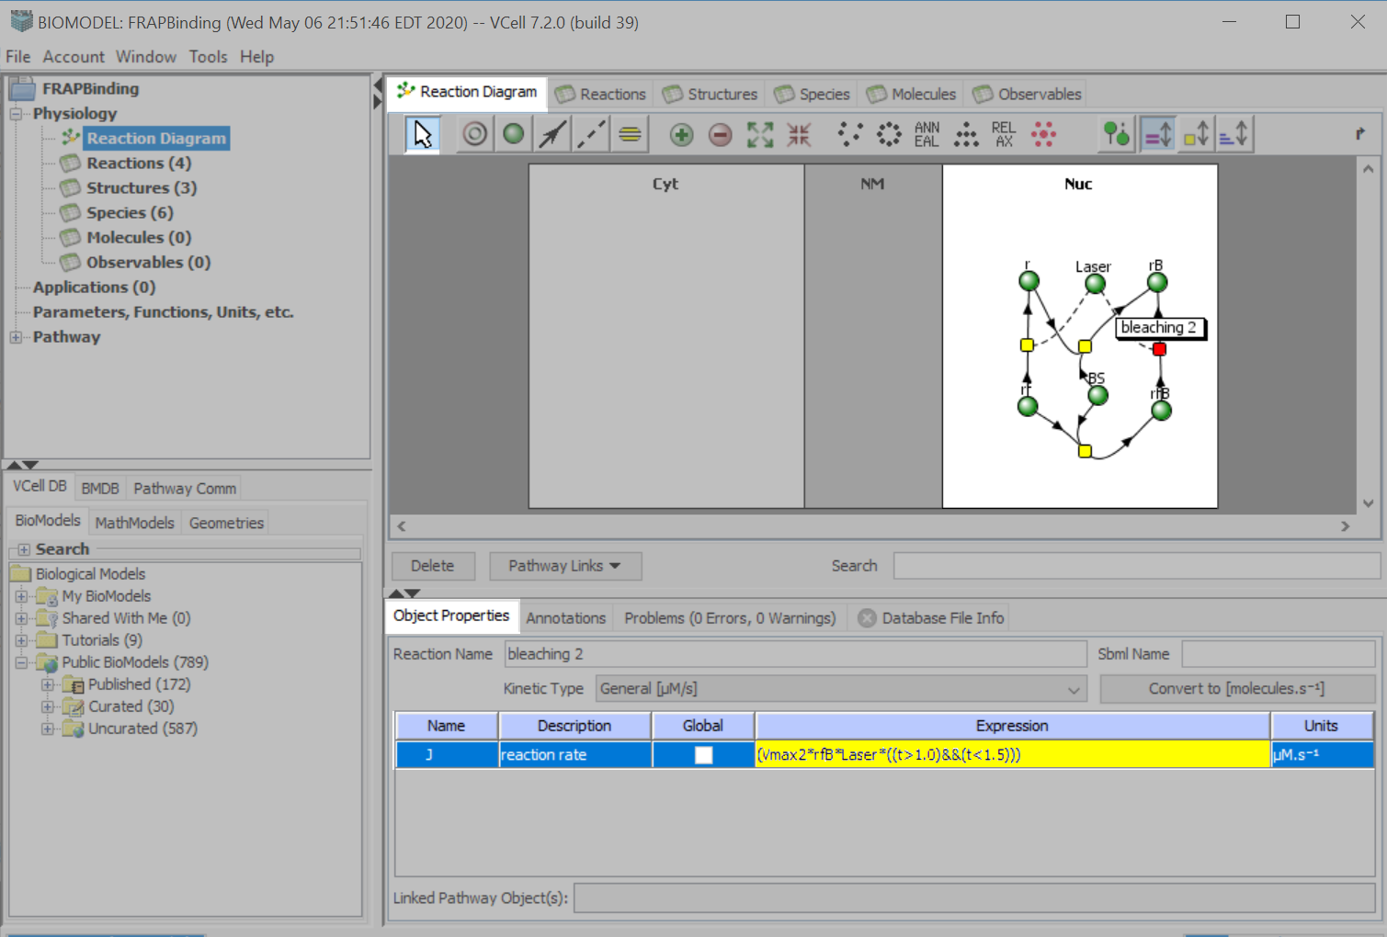
Ensure that the “bleaching 2” node is still selected.
Under the “Expression” column in the “reaction rate” text field, type:
“(Vmax2*rfB*Laser*((t>1.0)&&(t<1.5)))”. Press “Enter” on your keyboard to accept the entry.

Slide 41
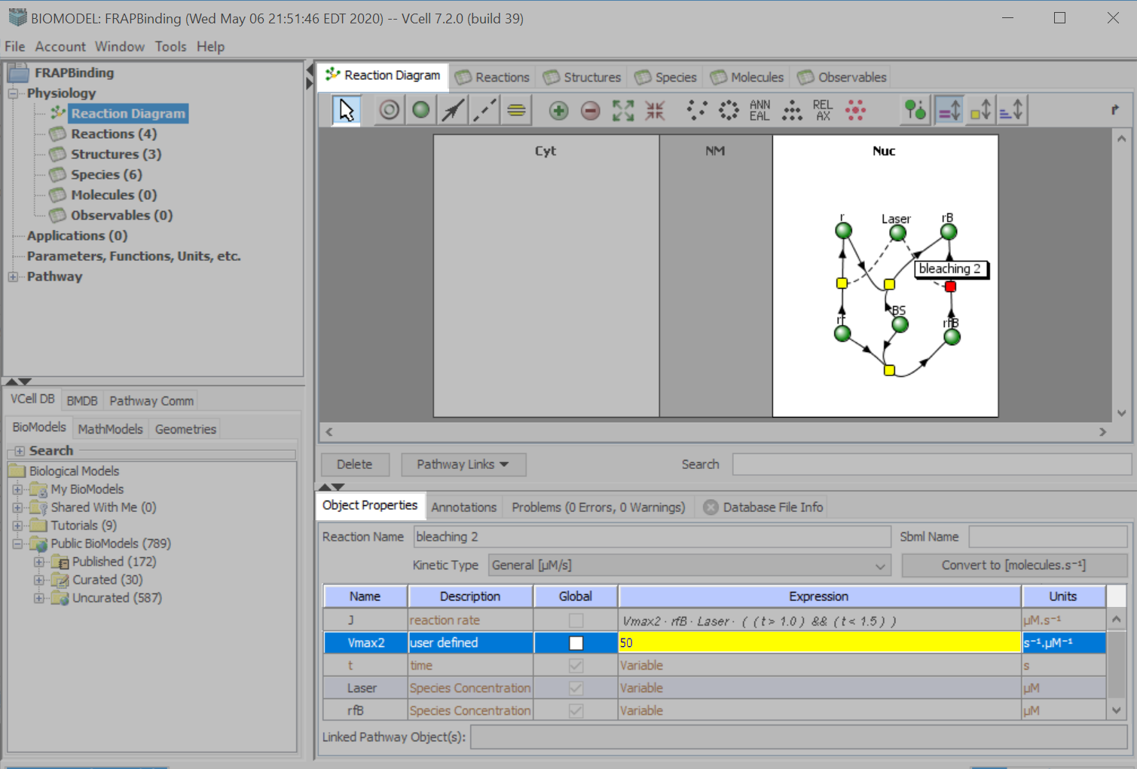
Ensure that the “bleaching 2” node is still selected.
Under the “Expression” column, in the “Vmax2” text field, type “50”.
Press “Enter” on your keyboard to accept your entry.

Slide 42
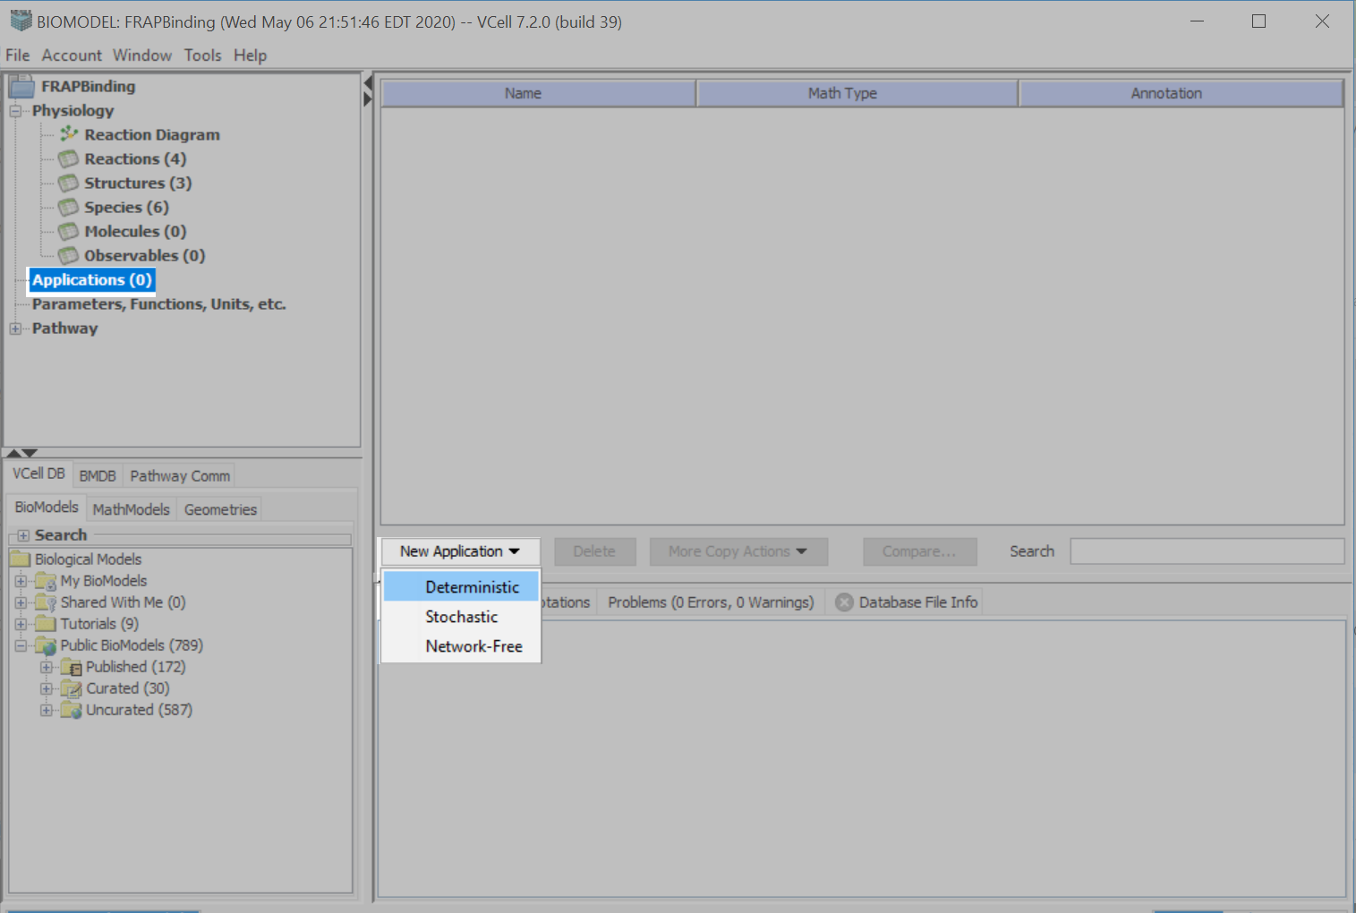
Click “Applications” > “New Application” > “Deterministic”.

Slide 43
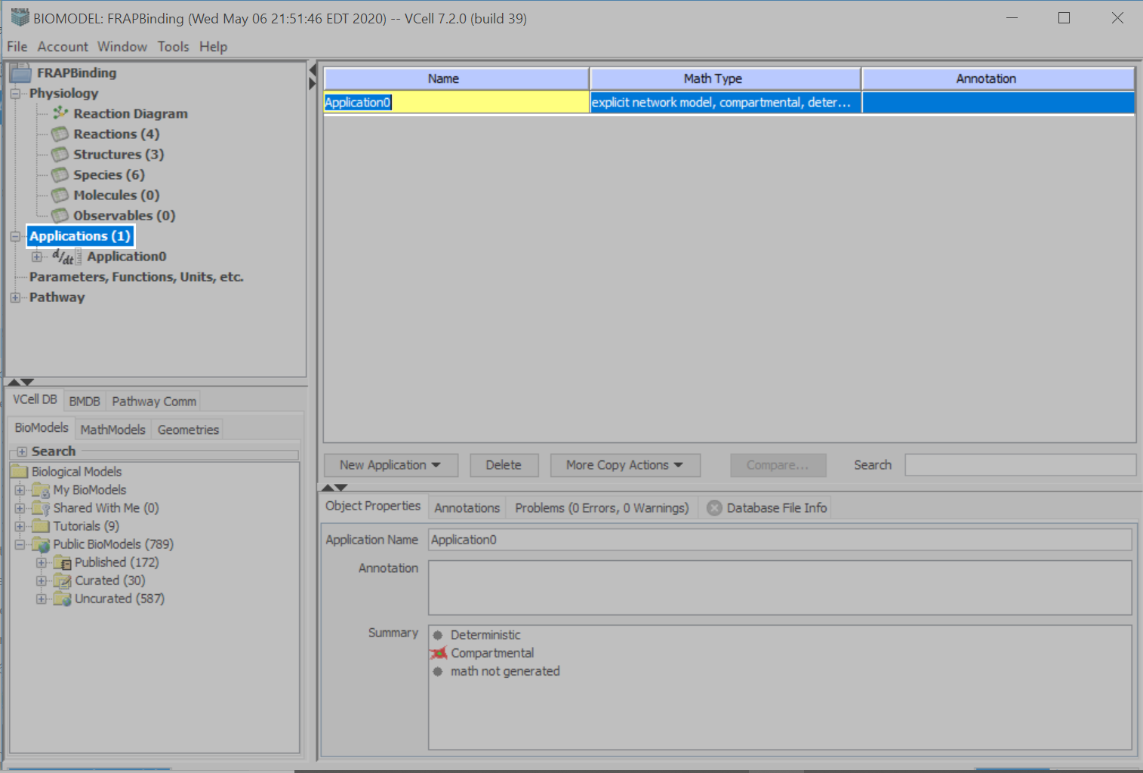
Double click “Application0” under the “Name” column.
Type in “Compartmental” and press “Enter” on your keyboard to accept your entry.
This compartmental application will be used to determine the steady-state concentrations for the binding reaction.

Slide 44
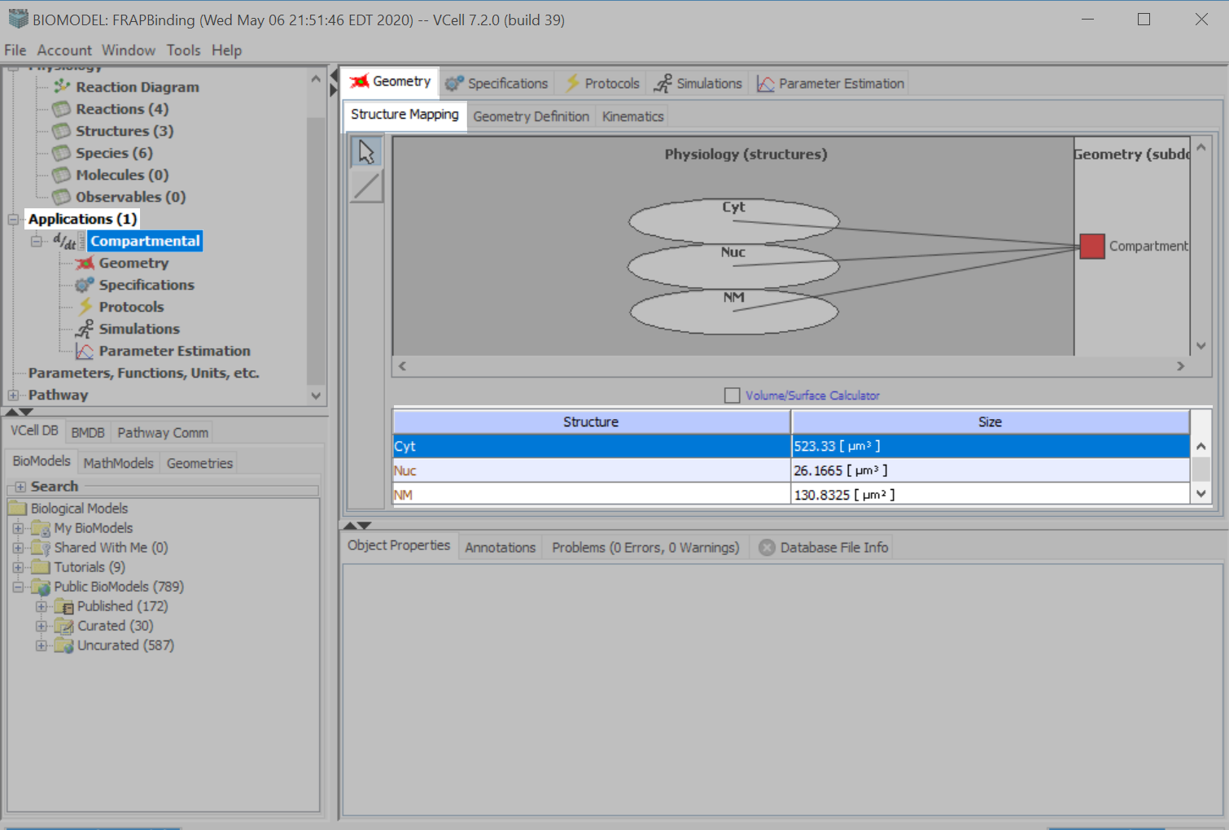
Double click “Compartmental” to access the “Geometry” > “Structure Mapping” menu.
In the “Size” column, enter the following numbers as listed in the table below for each structure. Press “Enter” on your keyboard to accept your entries.
Structure | Size
Cyt | 523.33
Nuc | 26.1665
NM | 130.8325

Slide 45
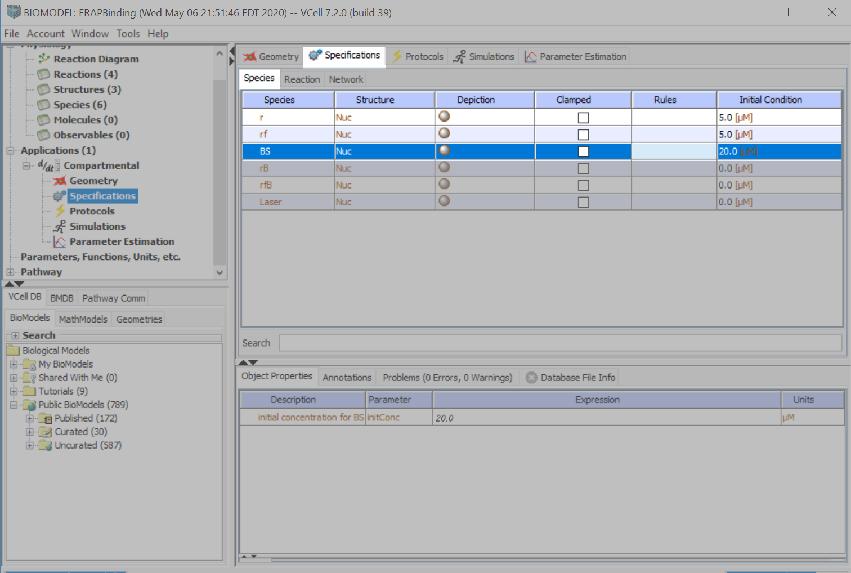
Click “Specifications” > “Species”.
In the “Initial Condition” column, enter the values for each species as listed in the table below. Press “Enter” on your keyboard to accept your entries.
Species | Initial Condition
r | 5.0
rf | 5.0
BS | 20.0

Slide 46
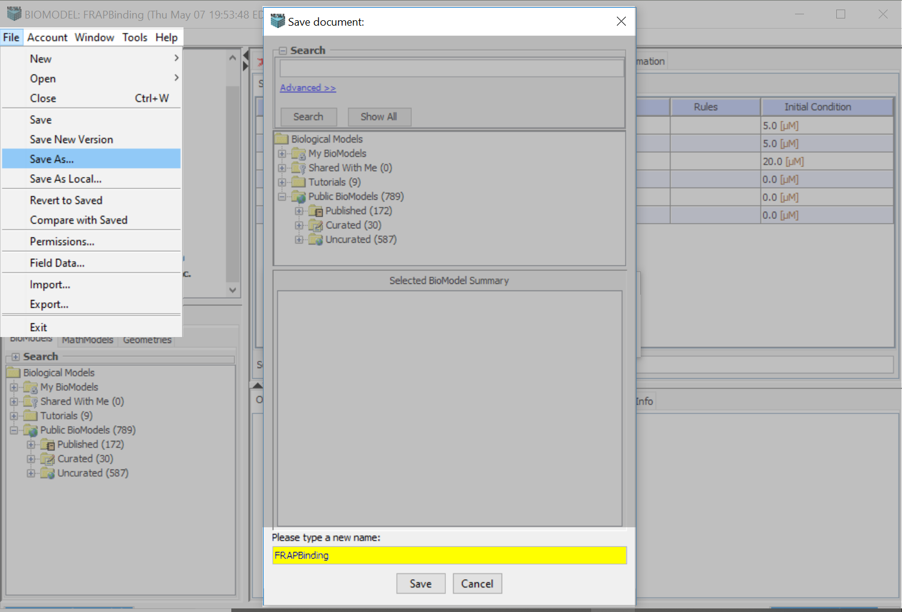
Now is a good time to save your model. Go to File>Save As…
Type a name, in the “Please type in a new name:” text field and press “Save”.

Slide 47
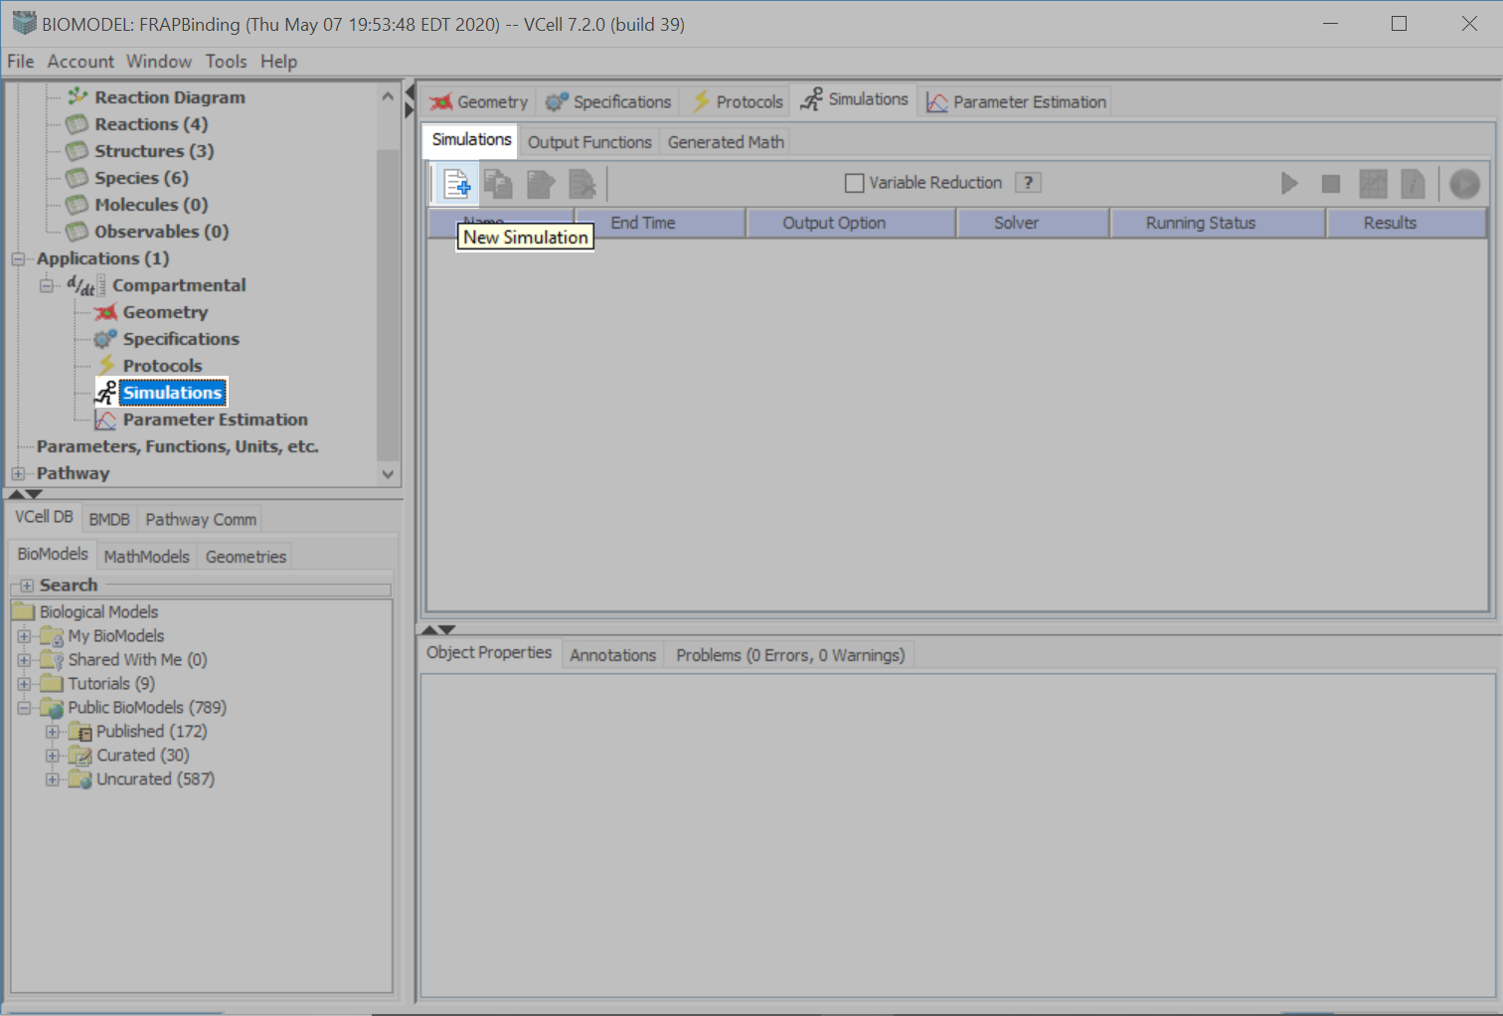
Click “Simulations” and the “New Simulation” icon.

Slide 48
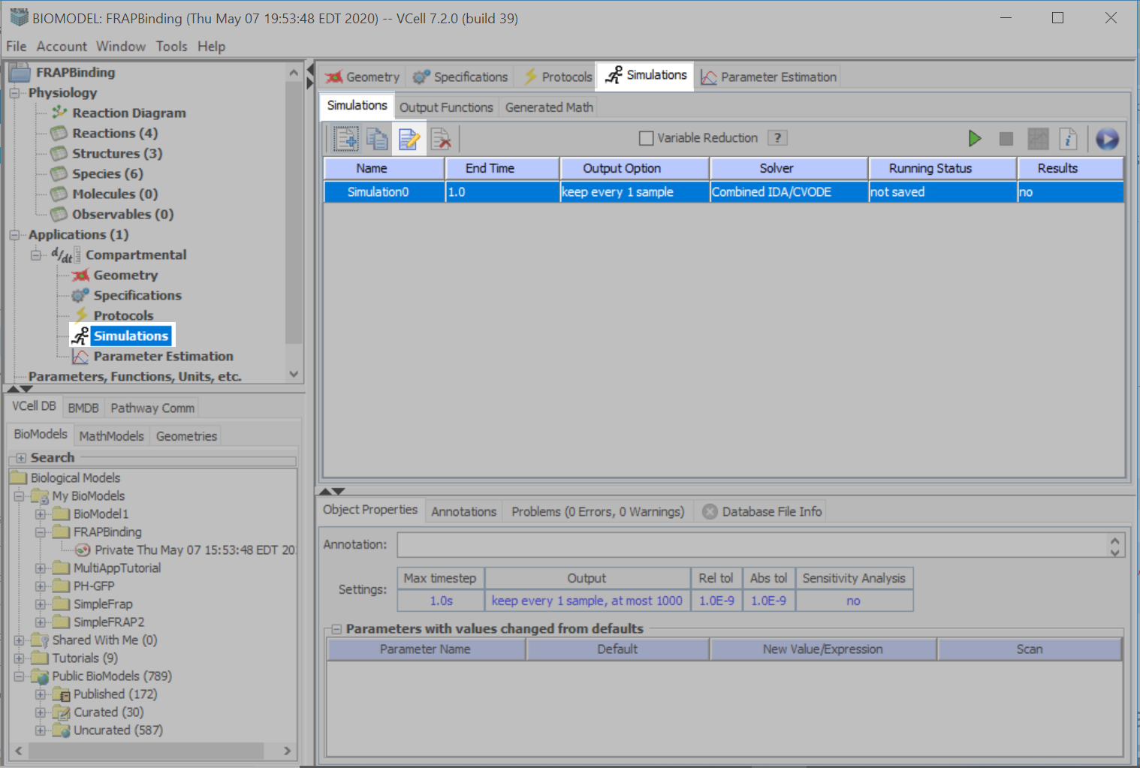
Click the “Edit Simulation” icon.

Slide 49
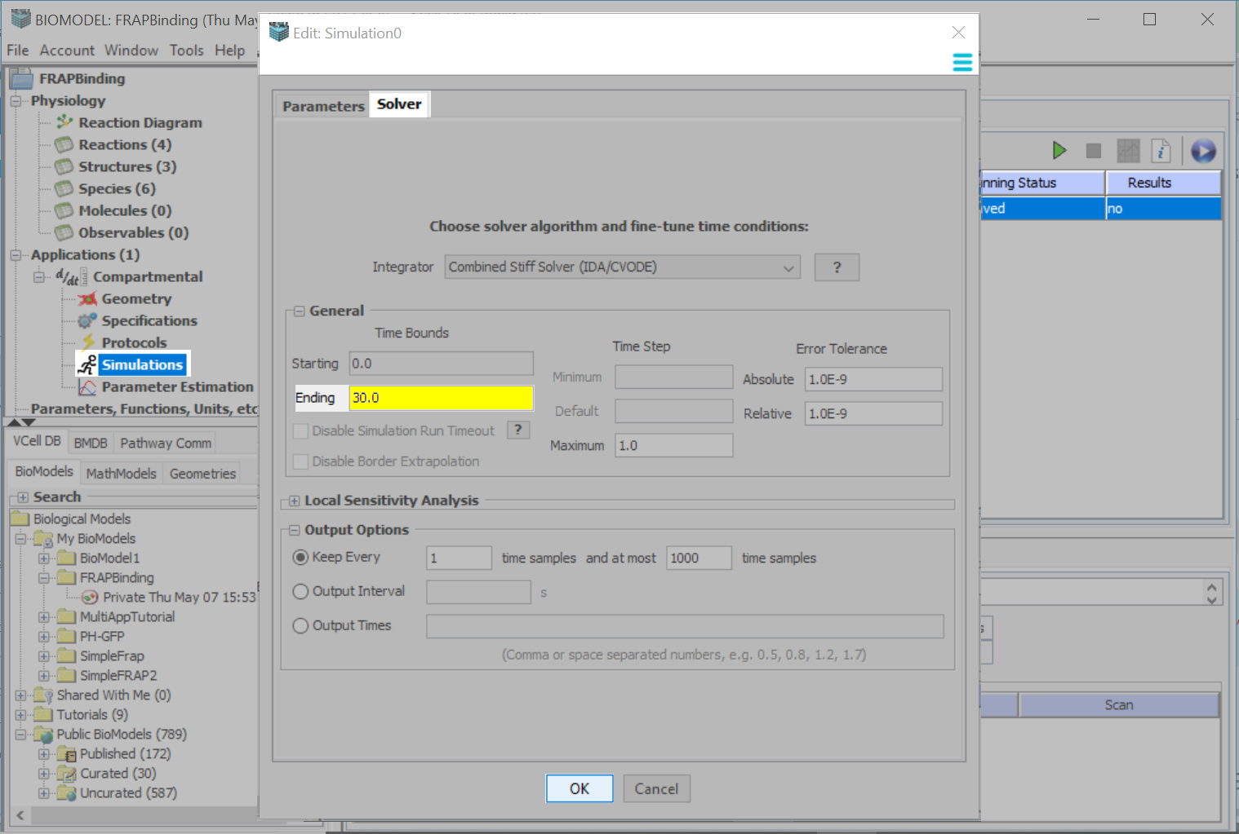
Click “Solver”.
Type Ending Time = 30.0
Click “OK”.

Slide 50
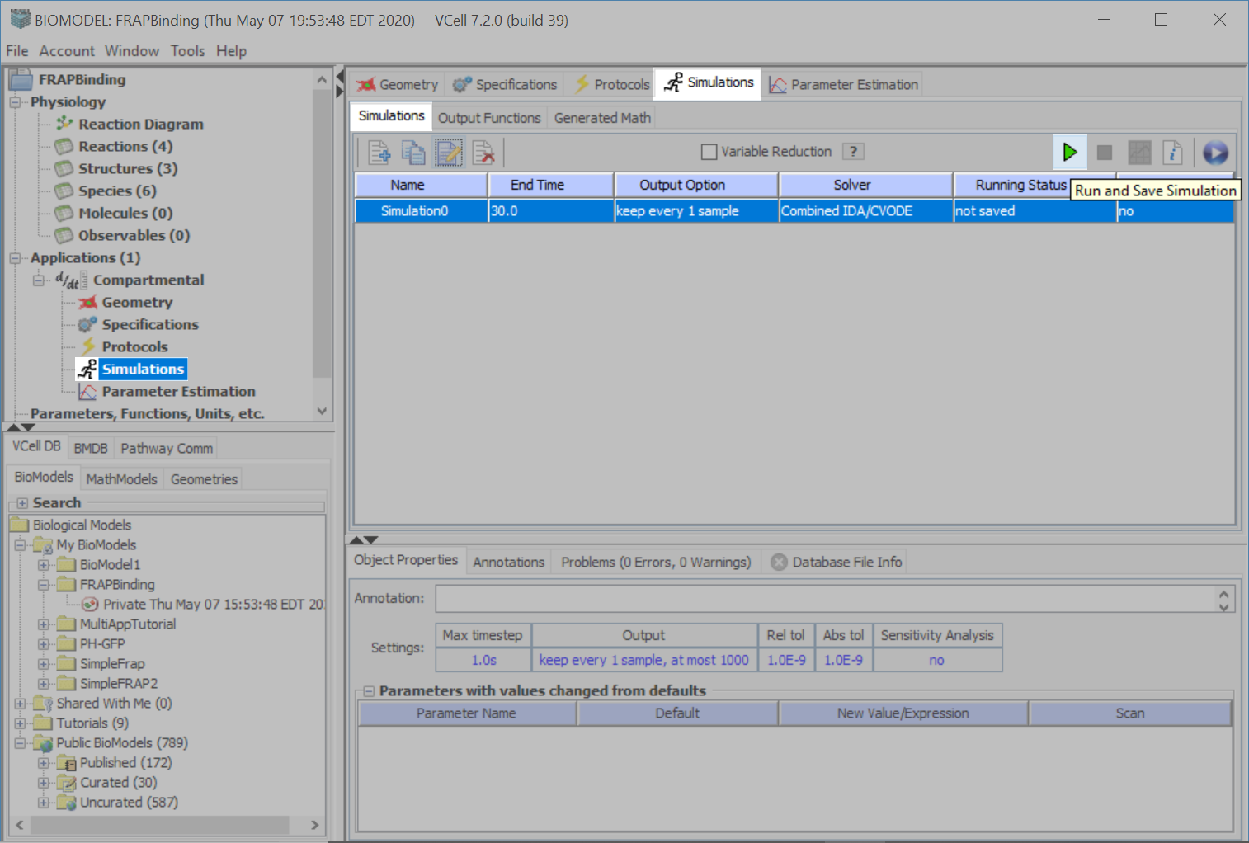
Click the green play icon to run and save the simulation.

Slide 51
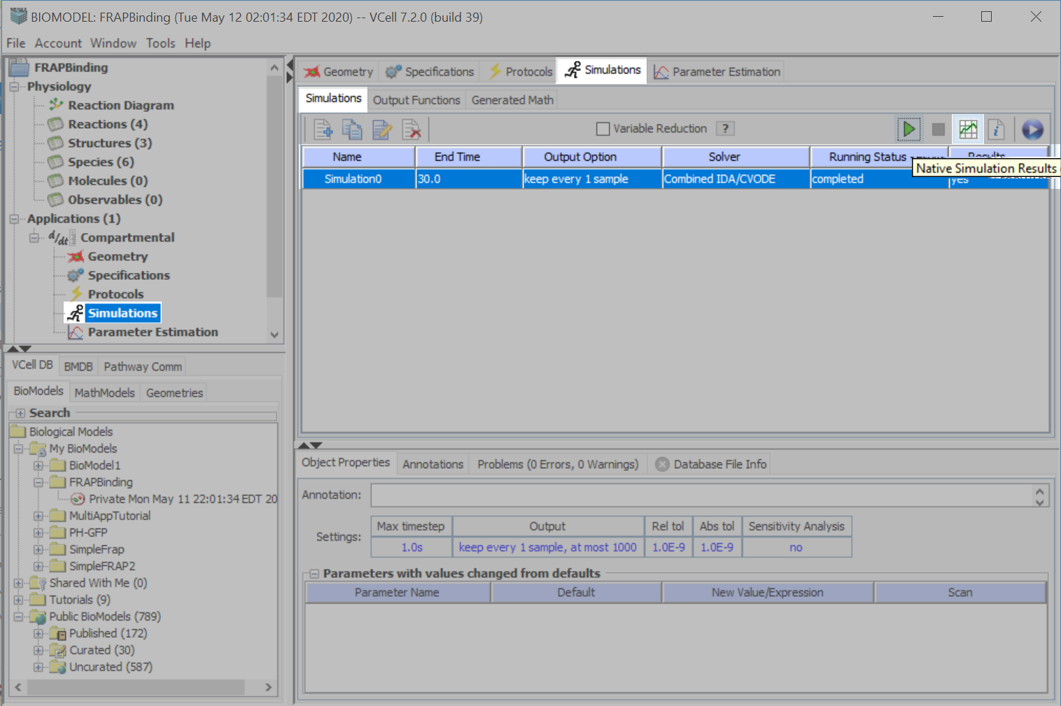
Click the “Results” icon when the simulation is completed.

Slide 52
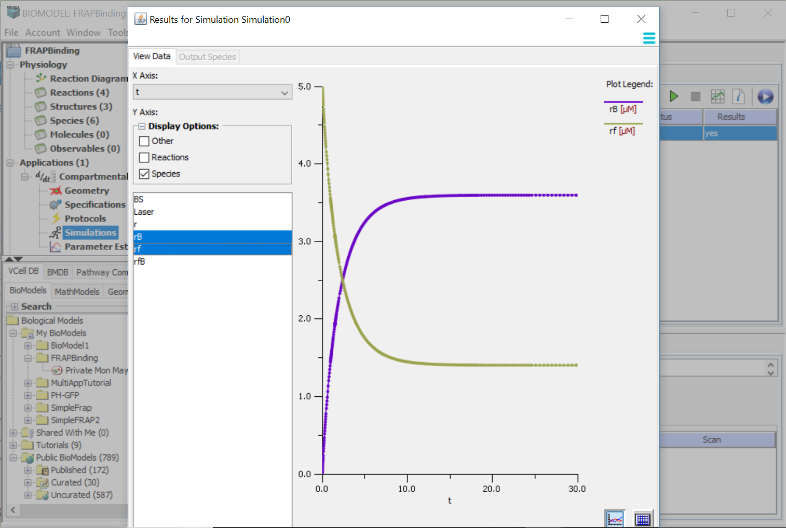
Click to exit.
Select the option you wish to view.
Press “Ctrl” on your keyboard and click on different species to view multiple species graphed at once.
Toggle between graph or spreadsheet view.

Slide 53

Select “Compartmental”, and then right click to access the “Copy” option.

Slide 54

Select the “Copy of Compartmental” and then right click your mouse button to access the “Rename” option.
Type “Spatial” and press “Enter” on your keyboard to accept your entry.

Slide 55

With “Spatial” still selected, select the “Geometry” tab and “Geometry Definition” tab.
Click “Add Geometry” > “New”.

Slide 56

Select “Analytic Equations (2D)”.
Click “OK”.

Slide 57

Double click “subdomain0” and type “Cyt”. Press “Enter” on your keyboard to accept your entry.

Slide 58

Click “Add Subdomain” > “Analytic”.

Slide 59

Click the drop down menu next to “Select Subdomain Shape:”, select “Circle”.
In the “Center Point (x,y)” text field, enter 0,0, and in the “Radius” text field, enter “10”.
Click “New Subdomain”.

Slide 60

Double click “subdomain0” and type “Nuc”.
Press “Enter” on your keyboard to accept your entry.

Slide 61

Click the black up and down arrows icon to toggle between a large and small “Slice View” window. VCell defaults to the small view.

Slide 62

Click the black up and down arrows icon to toggle between a large and small “Slice View” window. This is the large view.

Slide 63

Click “Edit Domain”.
In the “Size” text field, type “22” for X and Y.
In the “Origin” text field, type “-11” for X and Y.
Click “OK”.

Slide 64

Your “Slice View” should display a circle of radius 10 µm, inside of a 22 X 22 µm square.

Slide 65

Go to the “Structure Mapping” tab.
Use the “Line Tool” to drag a line from each “Structure” to its corresponding “subdomain”.
You must grab the “Line Tool” for each mapping.

Slide 66

Go back to “Applications” > “Compartmental” >“Simulations”.
Select the Simulation and press the “Simulation Results” icon.

Slide 67

Click “View Data”.
Click the spreadsheet icon.

Slide 68

select “BS”, and then press “Ctrl” on your keyboard to allow you to also select “rB”, “rf” and “rfB”.

Slide 69

Select “BS”, and then press “Ctrl” on your keyboard and click the final concentrations for “rB”, “rf” and “rfB”. Right click your mouse and select “Copy Cells”.

Slide 70

Click “Spatial” > “Specifications” and then select the “Species” tab.
Click on the “Initial Condition” cell in the “r” row and right click “Paste All”.

Slide 71

Click “Select All” and then click “OK”.

Slide 72

In the “Initial Condition” column for the “Laser”, type:
“((x>-2.0)&&(x<2.0)&&(y>-2.0)&&(y<2.0))”.
Press “Enter” on your keyboard to accept the entry.
The Boolean evaluates to “1” when x and y are between -2 and +2; everywhere else the Boolean evaluates to zero. In this way, the bleach reaction that is catalyzed by the laser only happens in a define region.

Slide 73

On the “Specifications” tab, click “Reaction”.
Click all the “Enabled” boxes for each reaction.

Slide 74

On the “Simulations” tab, select the Simulation and then select the “Edit Simulation” icon.

Slide 75

Click the “Mesh” tab.
Select “Lock aspect ratio” and type “51” in the X “Mesh Size (elements)” text field.

Slide 76

Click on the “Solver” tab.
Under “General>Time Bounds”, in the “Ending” text field, type “50.0”.
Under “Output Options, in the “Output Interval” text field,” type “0.5”.
Click “OK”.

Slide 77

Click the green “Run” icon to run and save the simulation.

Slide 78

Click the “Results” icon when the simulation is completed.

Slide 79

Change the time frame being viewed by typing in a value under “Time”, dragging the slider up or down, or by selecting the slider and stepping through the time points with your up and down arrow keys on your keyboard.
The minimum and maximum values correspond to the intensity profile.
Click here to select the “Species” data you wish to view.

Slide 80

Click on either “Gray” or “BlueRed” to change the color gradient.

Slide 81

Use the “Line” tool to establish two separate points. A line will automatically be created between the two points.
Use the “Selection” tool to delete or reposition the line.
Click “Plot” > “Spatial” to create a graph of the two points.

Slide 82

Use the “Time Point” tool to click in one or multiple areas.
Click “Plot” > “Time” to create your graph.

Slide 83

You can select one or multiple “Species” to compare concentrations over time. Use “ctrl” on your keyboard to select more than one “Species”.

Slide 84
Acknowledgements
The following students worked on this tutorial:
Tanya Miller (2015) – Pomperaug High School
Nathan Schaumburger (2017) – Hall High School
Arundeep Singh (2018) – Sport and Medical Sciences Academy
Zaiba Khan (2018) – East Windsor High School
Their work was supported by the Department of Health Career Opportunity Programs; the Aetna Foundation, Connecticut Collegiate Awareness and Preparation Program, Office of Higher Education; Connecticut State Legislative Fund; The Hartford; William and Alice Mortensen Foundation; John and Valerie Rowe Health Professions Scholars Program; the University of Connecticut Foundation; the Friends of the Department of Health Career Opportunity Programs and UConn Health.

